Slide 1
Department of Energy
FY 2012 Budget Overview
14 February, 2011

Slide 2
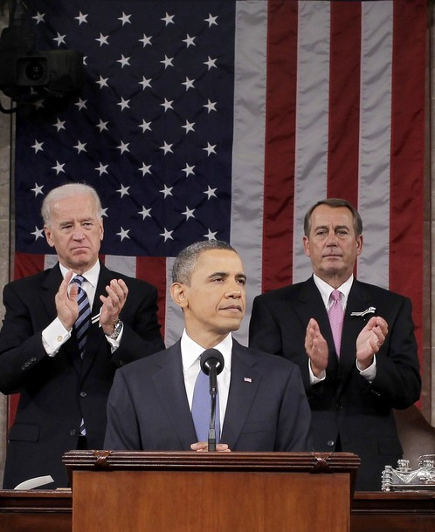
Winning the Future
“We know what it takes to compete for the jobs and industries of our time.
“We need to out-innovate, out-educate, and out-build the rest of the world. We have to make America the best place on Earth to do business. We need to take responsibility for our deficit and reform our government.
“That’s how our people will prosper.
That’s how we’ll win the future.”
-- President Obama, 2011 State of the Union

Slide 3
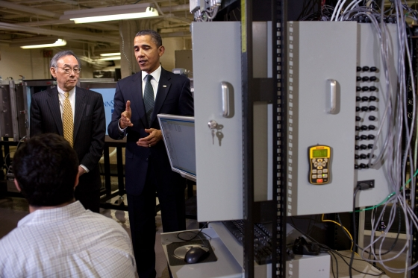
Supporting the President’s Plan to Win the Future
“Some of the most promising innovation is happening in the area of clean energy technology -- technology that is creating jobs, reducing our dependence on foreign oil, and … making sure our planet is a healthier place to live…” – President Obama, 2/3/11
Leading in clean energy innovation is key to long-term prosperity.
The Department of Energy FY12 Budget Request makes strategic investments to unleash American innovation and promote economic competitiveness.
Touring Penn State University Engineering Labs

Slide 4
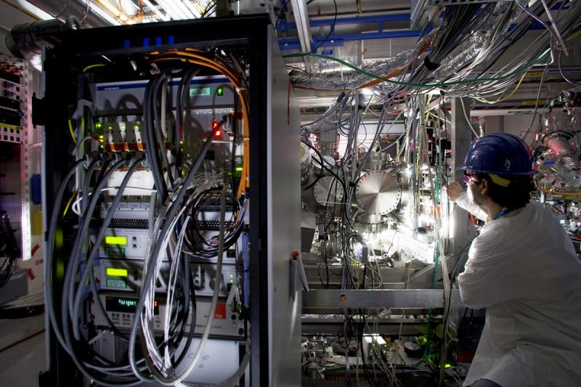
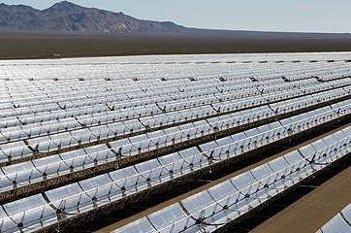
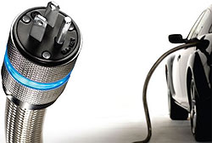
Strategic Investments in America’s Prosperity and Security
Department of Energy FY 12 Budget Request:
Supports cutting-edge science and research.
Marshals the nation’s brightest minds to discover and deliver new energy solutions.
Develops and deploys the clean and efficient energy technologies the world will demand in the coming years and decades.
Strengthens our security by reducing nuclear dangers and maintaining a safe, secure and effective nuclear deterrent.

Slide 5
FY 2012 Budget Request - $29.5 B
30
25
Energy
4.8
20
Environment
6.3
Dollars in Billions
NNSA
15
29.5
26.4
11.8
Science
10
5.4
5
Other
Loans
ARPA-E
-
0.4
0.3
0.6
FY10 Current
FY12 Request

Slide 6
Commitment to Fiscal Responsibility
Investing in what’s needed, cutting what’s not:
The President’s budget eliminates approximately $3.6 billion in tax subsidies for oil, coal, and gas industries – expected to generate more than $46 billion in revenue over the next 10 years.
Reducing funding for the Fossil Energy Program by $418m – 45%.
Reducing funding for the Office of Energy Efficiency and Renewable Energy’s hydrogen technology program by nearly $70m – more than 40%.
Making hard choices as part of a shared sacrifice:
Salary and bonus freeze for National Laboratory, site and facility management contractor employees. Money saved is reinvested in Labs.
Ending operation of the Tevatron and Holifield Radioactive Ion beam facility.

Slide 7
Improving Management and Operations
Reducing corporate management costs by $45m. We’re also reducing administrative expenses across all programs.
Consolidating programs that carry out the same mission, like the Office of Cost Analysis and the Office of Engineering and Construction Management.
Promoting good government and improving business practices.
- NNSA Supply Chain Management Center has saved $200m in procurement costs since 2007.

Slide 8
The Budget in Context
History of Department of Energy Funding
(Constant FY 2010 dollars, in billions)
Environmental Mgmt
Defense
Energy
Science

Slide 9
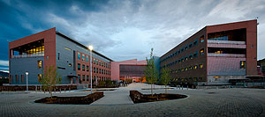

Saving Money by Saving Energy
New Better Buildings
Initiative, including $100 million loan guarantee program
$320 million to weatherize homes for low-income families

Slide 10
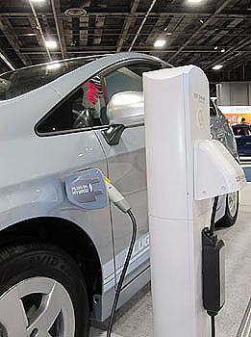
Leading in Electric Vehicle Technologies
Decreasing our dependence on imported oil, promoting leadership in an important growth industry:
Budget invests $588 million in vehicles to support President Obama’s goal of putting one million electric vehicles on the road by 2015.

Slide 11
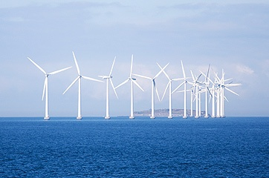
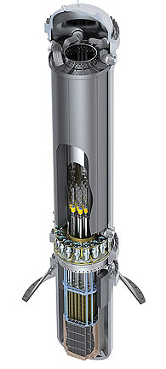

Leading in Clean Energy Technologies
R&D, Demonstration, and Deployment of:
Nuclear Energy
$0.9B
“SunShot” initiative: $425m -- includes support from EERE, ARPA-E, Office of Science
Offshore Wind: $64m
Geothermal energy: $59m
Fossil Energy
$0.5B
Budget also supports biomass, CCS and nuclear, including $97m for small modular reactors.

Slide 12
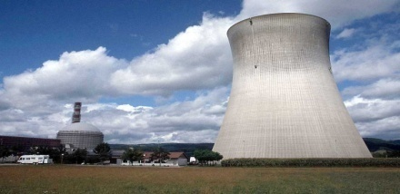

Deploying Clean Energy Projects
Restarting the American nuclear power industry with an additional $36 billion in loan guarantee authority. Combined with existing authority, this will support 6-8 projects.
Promoting renewable energy and energy efficiency projects with $300 million in credit subsidy to support $3 - $4 billion in projects.
Builds on progress made by the Loan Programs Office over the past 2 years: Committed more than $26 billion in loans or loan guarantees to support 23 clean energy projects, estimated to create or save 58,000 direct jobs.

Slide 13

Unleashing American Innovation
“What we can do -- what America does better than anyone else -- is spark the creativity and imagination of our people….In America, innovation doesn’t just change our lives. It is how we make our living.”
– President Obama, 2011 State of the Union
President’s budget maintains commitment to double investment in key basic research agencies, including Office of Science.
Provides $36 million – a 72% increase – to support the development of a skilled scientific workforce.
Positions the U.S. to maintain international leadership in scientific computing.

Slide 14



Supporting “the Apollo projects of our time”
Energy Innovation Hubs: $146 million to support 6 Hubs
“We’re issuing a challenge. We’re telling America’s scientists and engineers that if they assemble teams of the best minds in their fields, and focus on the hardest problems in clean energy, we’ll fund the Apollo projects of our time.” – President Obama, 2011 State of the Union
Existing: New:
Fuels from sunlight Batteries and Energy Storage
Energy Efficiency in Buildings Smart Grid Technology and Systems
Modeling & Simulation for Nuclear Critical Materials
Reactors
Builds on success of DOE’s Bioenergy Research Centers: Combined 66 inventions in the patent process in the first three years of operation.

Slide 15

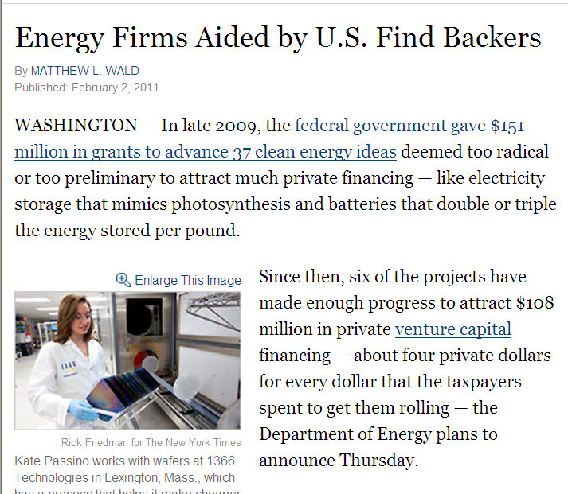
Supporting Potentially Transformational Research
Advanced Research Projects Agency – Energy: $550 million
Funding the development of potentially game-changing clean energy technologies
Budget Request builds on
ARPA-E’s progress

Slide 16
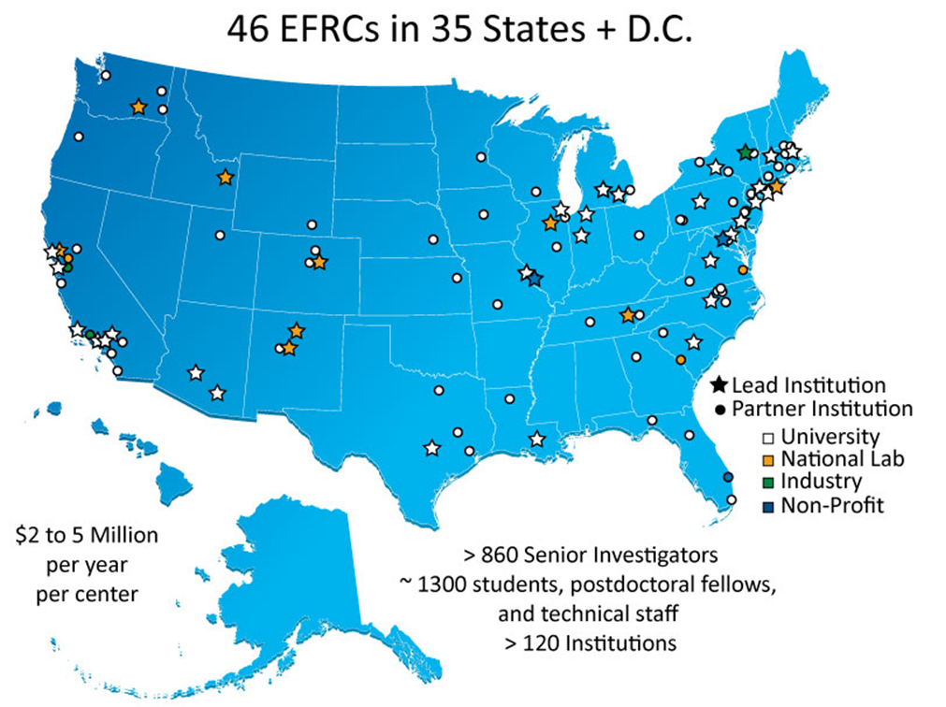
EFRCs: Breaking Down Barriers
Energy Frontier Research Centers: $100 million to continue supporting 46 projects started in 2009
Linking together small groups of researchers to clear scientific roadblocks that prevent energy breakthroughs

Slide 17

Supporting the President’s Nuclear Security Agenda
$11.8 billion for the National Nuclear Security Administration
Building on momentum over the past year:
Negotiation, Ratification and Entry into Force of New START Treaty
Release of Nuclear Posture Review
Historic Nuclear Security Summit
Secured nuclear material equivalent to more than 800 nuclear weapons
Completed and began operations at the world’s most secure HEU storage facility, the Highly Enriched Uranium Materials Facility at Y-12 National Security Complex
Installed radiation detection equipment in more than 65 border crossings, airports and seaports around the world to help prevent nuclear smuggling

Slide 18
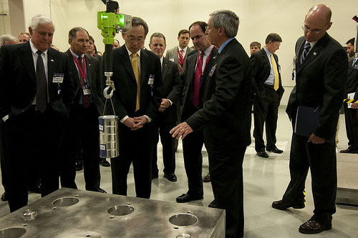
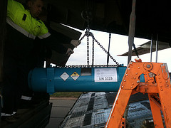
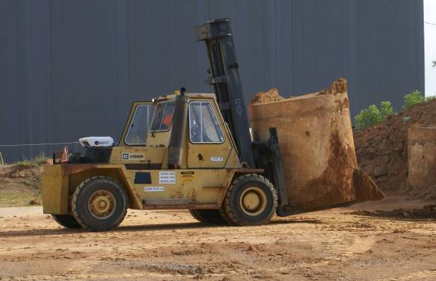
Reducing nuclear dangers and environmental risks
Modernize our Nuclear Security Enterprise: $7.6B
Part of $85B commitment over next 10 years
To promote stockpile management, infrastructure, science technology & engineering
Reduce the Risk of Proliferation: $2.5B
Part of $14.2B commitment over next 5 years
To support the President’s goal of securing vulnerable nuclear materials worldwide in 4 years
Environmental Clean-up
$6.1B
To clean up the Cold War legacy sites

Slide 19
FY 2012 Budget Submission

Slide 20
Energy Efficiency and Renewable Energy

Slide 21
Electricity Delivery & Energy Reliability

Slide 22
Fossil Energy

Slide 23
Nuclear Energy

Slide 24
Science

Slide 25
Advanced Research Projects Agency-Energy

Slide 26
Loan Programs
*
* $2 billion of loan authority was reprogrammed in FY 2010 from Mixed to Front End Nuclear.

Slide 27
National Nuclear Security Administration

Slide 28
Environmental Management
27

Slide 29
Corporate Management and Other Activities

Slide 30
Additional Budget Information
Additional budget information can be found at:
www.energy.gov

