Slide 1
Cyber Security – Our Shared Responsibility
National Cyber Security Awareness Month
October 20, 2011

Slide 2
Why do we care about Cyber Security?
Internet usage is a daily activity for most Americans
Our young children are using computers in Pre-K
Social network sites, on-line gaming, and mobile ‘techno gadgets’ such as IPODs and smart phones permeate every aspect of our teenagers’ lives
ALL of our personal information is located in cyber space somewhere at all times
Social media is the new social norm
And according to President Obama, “…the cyber threat has become one of the most serious economic and national security challenges we face.”
Notes:
The Internet has revolutionized the way we do business and commerce. We no longer connect to the Internet only through a desktop computer; we can get online at virtually any time from anywhere from all kinds of wireless devices, including cell phones, laptops, and tablets. Even when we are not directly connected, the Internet supports our everyday lives through our financial transactions, transportation systems, emergency response systems, and personal communication.
The tremendous technology that has greatly enhanced our lives with immediate access to resources and communication tools has also exposed us to tremendous adversarial threats such as identity thieves that attempt to steal our personal information or terrorists that desire to destroy our Nation’s infrastructure.

Slide 3
What are my risks?
Common questions all Cyberspace users should ask themselves…
  How do I protect my children?
  How do I protect my identity?
  How do I protect my bank account?
  How do I protect my personal information on my home computer?
  How do I protect government information at work and at home?
  Simply put, what is my shared responsibility in protecting my daily cyberspace?
Notes:
Protecting the shared Internet is Our Shared Responsibility. No individual, business, or government entity is solely responsible for securing the Internet. Every American has an important role in securing their part of cyberspace. Individual actions have a collective impact, and safe use of the Internet makes it more secure for everyone. If all Americans do their part by implementing stronger security practices, raising community awareness, educating young people or training employees, together we can foster a literate, resilient, and secure online society.

Slide 4



What can I do? Stop.Think.Connect.
Always STOP before using the Internet and have a firm knowledge of what you are about to do.
CONNECT with confidence!
Take time to THINK about your actions and your children’s actions online and how they could impact your safety.
Notes:
One simple solution is to follow the national campaign, STOP.THINK.CONNECT. The idea behind the slogan is that when all Internet users follow these simple steps to be safer online and take responsibility for their cyber actions, then using the Internet becomes a more secure experience for everyone.

Slide 5
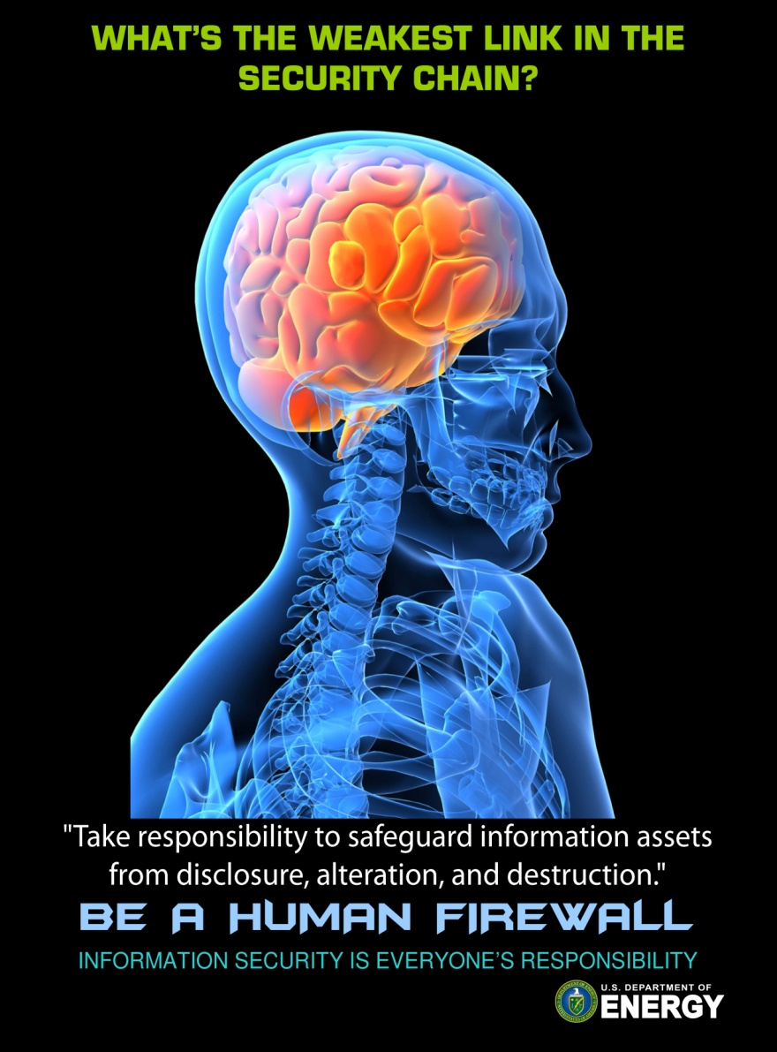
What about the office environment?
Shared responsibility to follow required cyber policies and practices
Shared responsibility to protect DOE information assets at work and at home
Shared responsibility to be cyber aware of possible cyber threats
A cyber-aware workforce is an
empowered workforce.
Notes:
Principles of Stop.Think.Connect. Can be applied at work as well home.
Understand and follow cyber security policies and procedures.
Know who to contact if you have a cyber security question….your HSO representative or the Office of Cyber Security.

Slide 6
Unfortunate Circumstance
An real-life example of a common social engineering cyber threat with significant consequences…
  Breach originated in a phishing e-mail sent to hundreds of employees at Oak Ridge National Labs.
  E-mail was disguised as an official e-mail from the lab’s HR department about benefit changes.
  Employees clicked on the embedded link in the e-mail.
  Malware was downloaded onto their computers.
  Malware exploited an unpatched flaw in MS Internet Explorer and was designed to search for and steal technical information.
  As a result of this breach, the lab shut down all Internet access and email services.
  Many resource hours spent during investigation, research, and mitigation.
Notes:
Excerpt from Computer World, April 2011.
Oak Ridge, a U.S. Department of Energy-run research lab, this week disclosed it had shut down all Internet access and email services after discovering a sophisticated data stealing malware program on its networks.
According to the lab, the breach originated in a phishing email that was sent to about 570 employees. The emails were disguised to appear as notes about benefits changes written by the lab's HR department. When a handful of employees clicked on the embedded link in the email, a malware program was downloaded onto their computers.
The malware exploited an unpatched flaw in Microsoft's Internet Explorer software, and was designed to search for and steal technical information from Oak Ridge, whose engineers are in the midst of an effort to build the world’s fastest supercomputer.

Slide 7
DOE Risk Management Approach
DOE Risk Management Approach (RMA)
  The OCIO has established a RMA based on NIST Special Publication (SP) 800-39 that institutes a mission-centric, risk-based approach to the management of cyber security to ensure the confidentiality, integrity, and availability of DOE information and information systems.
  Developed as a collaborative effort between HQ, Under Secretaries, National Labs, Production Facilities, and the IMGC Advisory Group and representatives.
  Provides the foundation for risk-based decisions that effectively ‘balance’ security, cost and mission effectiveness as opposed to a system-level compliance approach.
  DOE RMA Principles – Risk is Managed in Partnership with the Mission
  IT, Cyber, and Departmental mission needs are effectively ‘balanced’ by the evaluation of value, affordability, and mission impact as determined by the mission owners.
  The IT/Cyber relationship is one of partnership, cooperation, and collaboration of common tools, best practices, centers of excellence, etc. at both the Federal and Contractor-level.
  Ultimate Goal of the DOE RMA
  The ultimate goal of the DOE RMA is to provide a structured, yet flexible approach for managing risk that is intentionally broad-based, and that protects DOE information assets in a manner commensurate with impact to mission, national security, risk, and magnitude of harm.
Notes:
Immediate and sustainable benefits of the DOE RMA:
There is common, shared vision by all M&O’s and federal officials regarding risk management.
Through partnership and collaboration, an enterprise-wide environment is created for the development of innovations and implementation of solutions to emerging threats.
An emphasis is placed on real-time protection of threats in advance to regulations.
Roles and responsibilities are clearly defined and understood at all levels (site, operating unit, HQ, etc.).
NIST SP 800-39 provides National guidance for risk management in a ‘tiered’ approach. Basically, risk analysis and decision making are performed at three
different levels in an organization, therefore providing an ‘organizational’ or broad perspective to risk management as opposed to system specific.
Level 1 Organization
Level 2 Mission/Business Process
Level 3 Information System
At all levels of DOE, the RMA must include the four components of risk management: framing; assessing; responding; and monitoring.
Risk framing (Step 1) and the risk assessment (Step 2) are completed in partnership with DOE oversight.
Risk response (Step 3) ensures the defensive protections are adequate for the agreed upon risk profile. For example, at the DOE site level, the Senior Contractor Site Manager is accountable (e.g. Laboratory Director, Plant Director) for ensuring the defensive protections are adequate to mitigate the risk profile agreed to by the Federal Site Manager and Senior Site Manager.
In Risk Monitoring (Step 4), the site is responsible for developing an ongoing monitoring approach (also referred to as Contractor Assurance System) to evaluate and respond to changes in the environment and assess overall performance. This monitoring approach is coordinated and validated with DOE oversight.

