Slide 1
DOE PM Workshop
Owen F Barwell
Deputy CFO
April 2012

Slide 2
Agenda
Role of the CFO
Audit risks
Assets/Liabilities/Balances
Current challenges
FY13 budget
FY14 and beyond
Question and answers

Slide 3
Role of the CFO
Culture
Operational responsibilities
  Policy
  Internal controls
  Financial management
  Budget
  Business and information systems
Stakeholder relationships
  DOE/BQR
  OMB
  Hill
Notes:
Professional
Smart
Independent

Slide 4
Audit risks

Slide 5
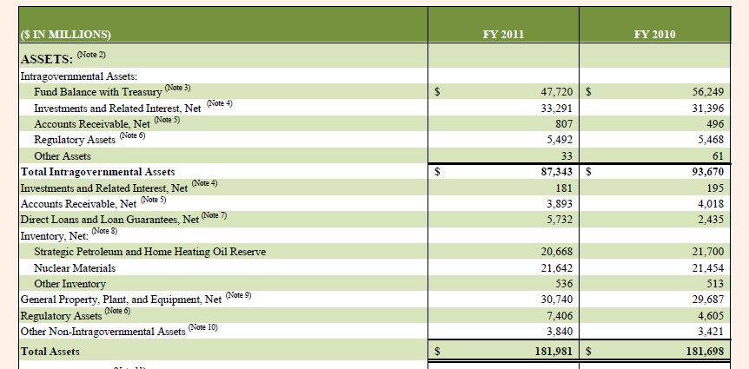
Assets
Source: http://www.mbe.doe.gov/cf12/2011PARafr.pdf
Notes:
Exxon Mobil $330B
GE running about $700B in assets, roughly 4 times

Slide 6
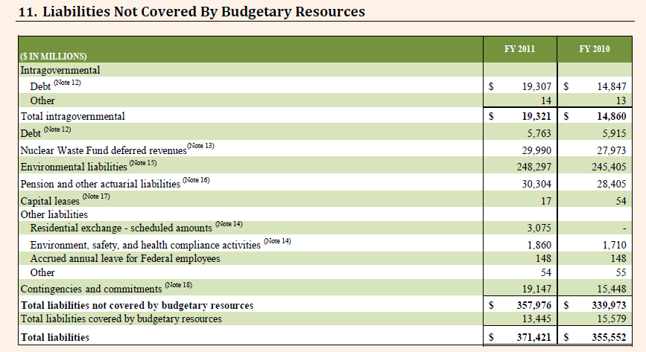
Liabilities
Source: http://www.mbe.doe.gov/cf12/2011PARafr.pdf
Notes:
Greece bail our 110M Euro, at 1.33 E to $, 2.5 times Greece bailout

Slide 7
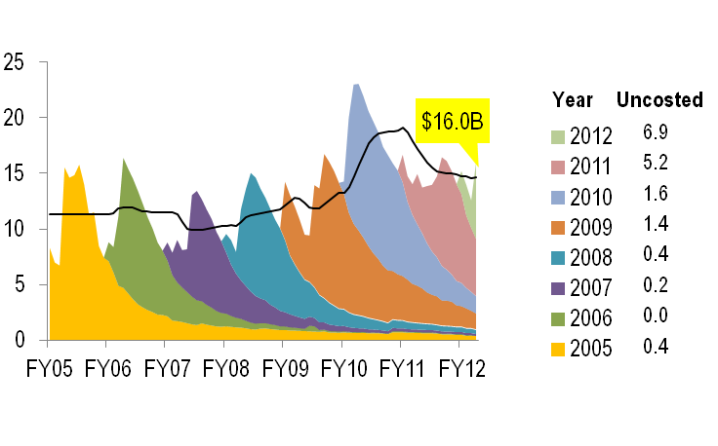
Balances

Slide 8
Current challenges
DOE Management Priorities
Contract and Project Administration
Acquisition Process Management
Security
Environmental Cleanup
Nuclear Waste Disposal
Cyber Security
Human Capital Management
Safety & Health
Recovery Act
OIG Management Challenges
Operational Efficiency and Cost Savings
Contract and Financial Assistance Award Management
Cyber Security
Energy Supply
Environmental Cleanup
Human Capital Management
Nuclear Waste Disposal
Stockpile Stewardship
GAO High Risk
Protecting energy R&D and key assets
Security of nuclear weapons stockpile and IP
Nuclear nonproliferation
Contract administration and project management for large and complex projects
Human Capital Management
Both internal and external stakeholders continue to recognize the challenges of procuring and managing our large and complex projects

Slide 9
FY13 Submission

Slide 10
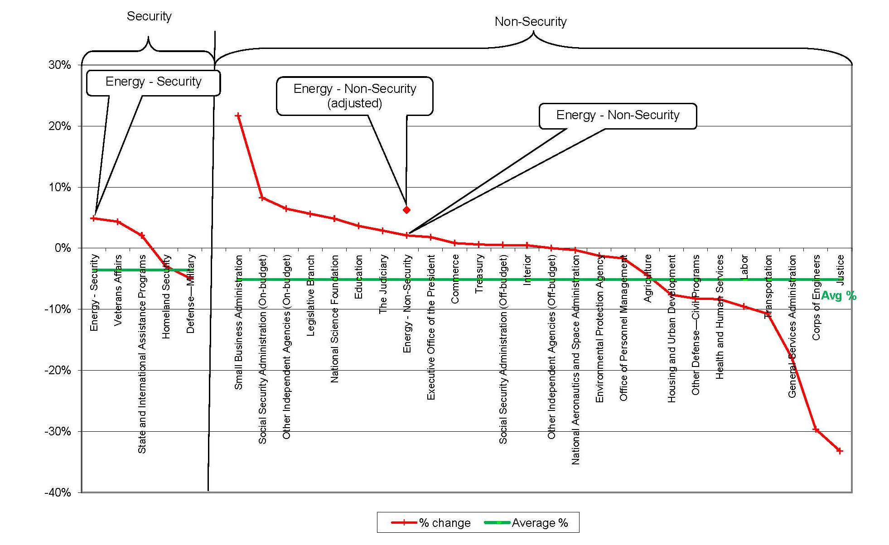
FY13 from FY12

Slide 11
FY14 and beyond
Environment
FY14 budget
  Strategy
  Process
Out years
  Multi-year budgets
    Credible cost estimates
    Project/funding profiles
    Project prioritization
    Financing
Management challenges

