Slide 1

SNL Z Facility
UR/LLE OMEGA
NNSA Acquisition &
Project Management
Bob Raines
Associate Administrator for Acquisition
and Project Management
April 5, 2012

Slide 2
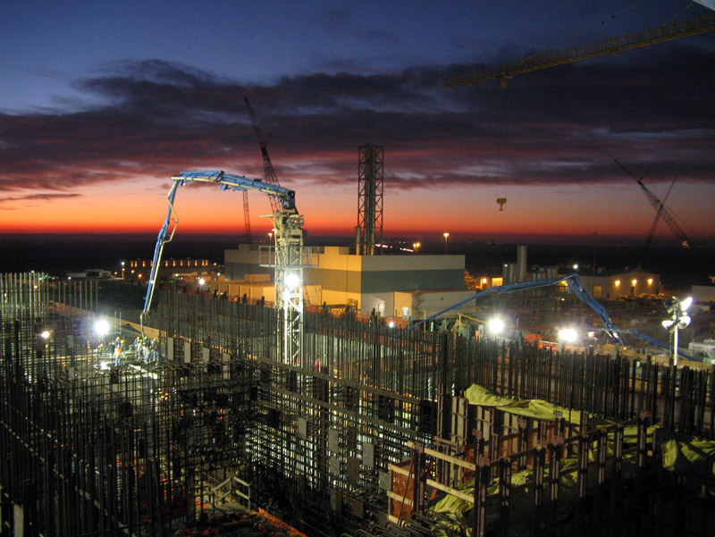
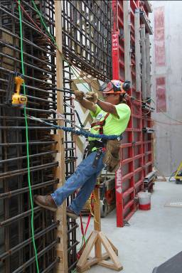
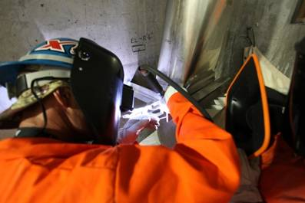
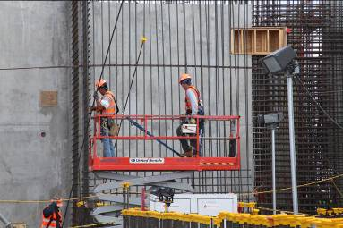
Safety

Slide 3
Why an APM?
Historical, institutional inability to deliver capital asset acquisition projects on budget and schedule
  Contract and project management not integrated
  Insufficient resources, numbers and skills, in construction contract management
  Unclear requirement generation and scope management
  No independent cost estimating capability
  Anecdotal successes not institutionalized for Enterprise success
APM addresses these deficiencies by:
  Core competencies as acquisition and construction project management professionals
  Enterprise Construction Management Services and Interagency Agreements to support federal staff
  Independent cost estimating capability
  Enterprise-wide policy and execution team
  Bright line between government/contractor requirements generation
Supports the One NNSA Vision – Partnership across the enterprise

Slide 4
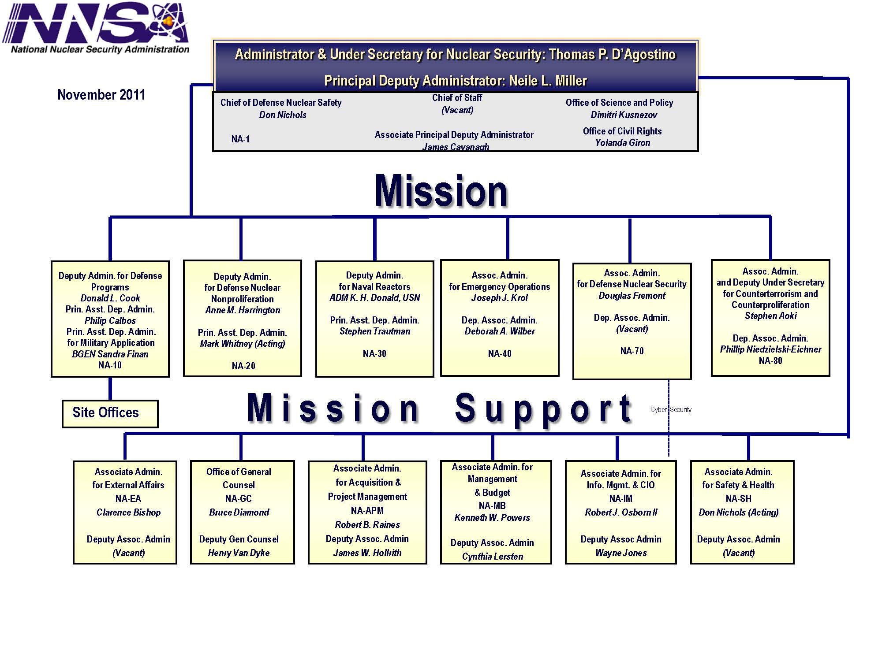

Slide 5
Guiding Principles
Promotes a culture of safety
Provides cost effective solutions; redirect project savings to mission accomplishment
Delivers quality projects, on-time and on-budget
Develops a competent workforce and plans for workforce replacement/reconstitution
Takes ownership and is accountable for results
Functions in high performing integrated teams
Fosters collaborative relationships
Adopts best practices, technologies and techniques

Slide 6
Capital Asset Projects Concept of Operations
CD0
CD1
CD2
CD3
CD4
Program
APM
Pre Project Planning
Project Execution
Operations
Mission Need
Program Requirements
Nuclear Safety Rqmnts
Maintainability
Operability
Permitting
Site Services (Sec. Utilities, badging, etc.)
Alternative Analysis
Acquisition Planning
Cost Estimating & Analysis
Conceptual Design
Preliminary Design
Advance Procurements
Acquisition Execution
Final Design
Construction
Cost , Scope, and Schedule Control
Commissioning and Final Inspection
Operational Evaluation
Startup
Operations

Slide 7
NNSA’s Project Improvement Strategy
Best-in-class contractors compete for:
  Enterprise Construction Management Services (ECMS) for front end planning, alternative analysis, and field support during execution
  Separate design and construction contracts (direct federal contracts)
  Improved acquisition planning and strategies
M&O contractors focus on what they do best:
  Management and Operations of facilities
  NNSA mission support, research and analysis
  Capital Construction where it makes sense
Change the Acquisition and Project Mgmnt Culture
  Broader universe of options
  Instill PM discipline within the M&O when they are used

Slide 8
Changing Acq & PM Culture
F
FP
PIF
PAF
P(EPA)

Slide 9
Think Different
Deliver on the Contract Price and Schedule – Not TPC
Army Corps of Engineers/Naval Facilities Engr Command
  LANL, Pantex and Y-12
  Exploring Enterprise Partnership
M&O’s as CM’s for Federal Contracts
Multi Year Fees
Capital Asset Project Specific Fees
Performance Counts
Emphasize Front End Planning
  Design Management Baselines
  Affordability
  Alternative Analysis

Slide 10
Enterprise Construction
Management Services
Contract fills skill and quantity gaps
  Engineering News Record Top 100 Firms Interested
  Best Value Source Selection
Key deliverables:
  Alternatives analysis
  Independent Cost Estimates
  Project Controls Expertise
  Acquisition planning
  Staff Augmentation
Parsons – Awarded Jan 2012

Slide 11


Small Business

Slide 12
Insomnia

Slide 13
State Construction Employment Change
Jan 2011 to Jan 2012
-10% or worse
-5.0% to -9.9%
-0.1% to -4.9%
0% to 4.9%
5% or better
2%
NH
6%
3%
5%
0%
4%
16%
5%
VT
5%
-4%
-2%
-0.3%
-1%
2%
-1%
MA
-2%
-8%
5%
6%
4%
0%
-5%
3%
3%
7%
9%
CT
2%
RI
-2%
6%
-1%
0%
2%
DE
-5%
NJ
3%
2%
-3%
3%
-0.1%
12%
1%
4%
-3%
MD
3%
DC
12%
-3%
-9%
3%
-5%
-1%
-6%
HI
-3%
Source: Ken Simonson, AGC: BLS state and regional employment report
13

Slide 14
Change in Producer Prices for Construction vs.
Consumer Prices vs. ENR Construction Cost Index
PPI for inputs to construction industries: 52%
ENR Construction Cost Index: 39%
Consumer price index: 24%
Jan 2012
Sources: Bureau of Labor Statistics (consumer & producer price indexes – monthly); ENR Construction Cost Index History

Slide 15
Materials & labor costs vs. office & highway bid prices
PPI for materials
March 2009=100
ECI
PPI for offices
NHCCI
2009
2010
2011
Source: Ken Simonson, AGC, based on Bureau of Labor Statistics for Producer Price Indexes (PPIs) and Employment Cost Index (ECI); Federal Highway Administration for National Highway Construction Cost Index (NHCCI)

Slide 16
Trends: 2013-2017
Total construction spending: +6% to +10% per year
  Largest Growth in Power – Our Competition
Materials costs: +3% to +8% (vs. 2% to 3% for CPI)
Labor costs: +2% to + 4%
Bid prices: +2% to +5%
Source: Ken Simonson, AGC Author
16

Slide 17
Courage
“Courage is the first of human virtues because it makes all other virtues possible.” Aristotle
“It takes courage to acknowledge when reality has changed, when an initial plan, however well-intentioned, is no longer the right plan and when a change in policy will enable us to do other things. Such courageous decisions then make other things – other ventures, and other virtues – possible.” Tom Friedman
PDC, CMRR, UPF, Y-12/PANTEX

Slide 18
Take Aways
Focused Leadership Attention on APM
Partnership Across the Complex
FPD and CO interface is key
Agile staff augmentation dictated by workload
Improvement is an Imperative
Be Bold…Be Courageous

Slide 19
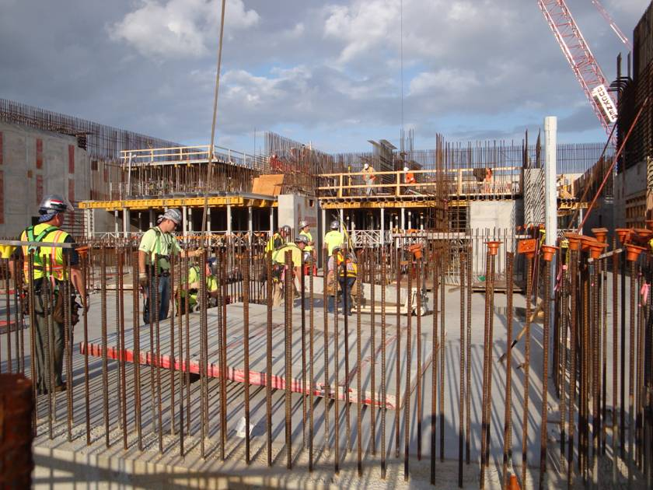
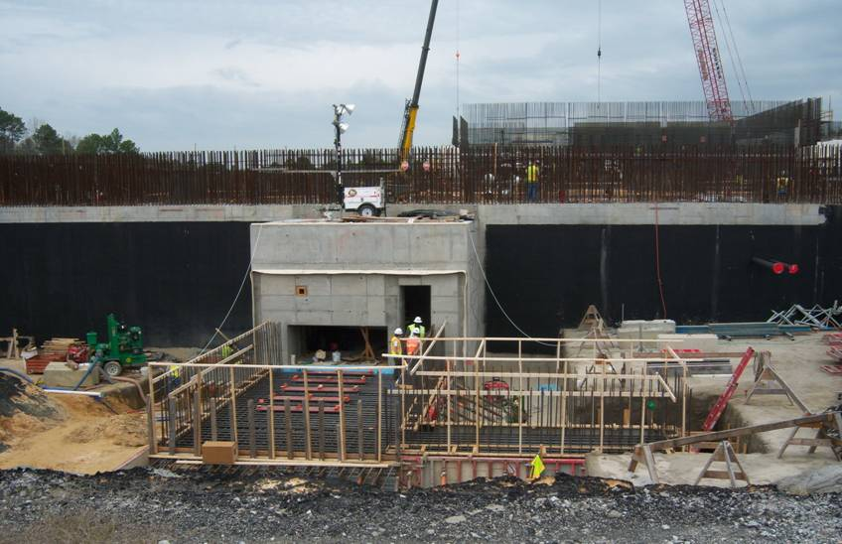
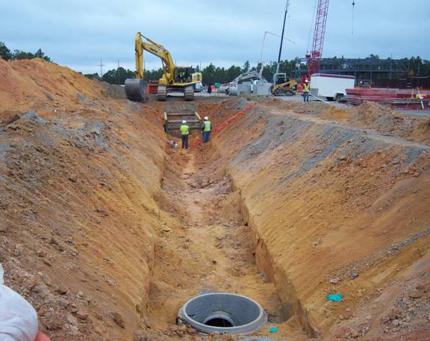
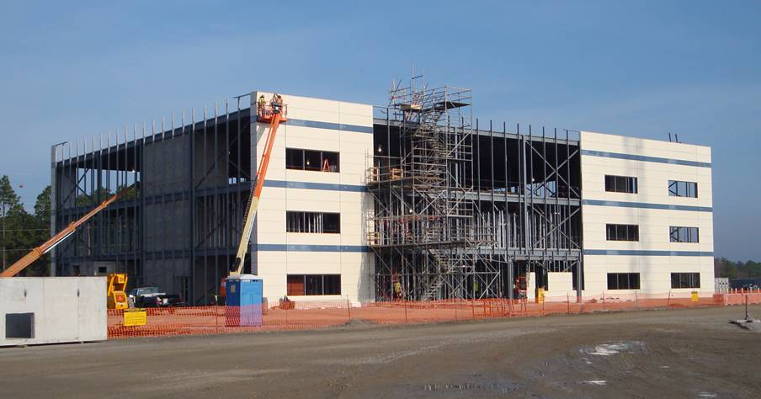
Questions

