Slide 1
THE OECM PARS II / EVM ROADSHOW
Enhancing Earned Value (EV) Analysis
Using
Project Assessment & Reporting System (PARS II)
Presented by:
Melvin Frank
Team Lead, Project Management Systems
Office of Engineering and Construction Management
U. S. Department of Energy
April 3-4, 2012
Achieving Management and Operational Excellence

Slide 2

Why are We Here?
Share information relative to new and improved PARS II reports and EVMS surveillance and analysis processes
Provide information to improve communication and proficiencies working with PARS II and Earned Value Management
  Provide a forum to exchange best practices concerning PARS II and EVMS procedures and implementation across the complex
Who will benefit from this training?
  DOE HQ Project Mgmt / OECM
  DOE HQ Project Mgmt Support Office (PMSO) staff
  Federal Project Directors (FPDs) and Contractor Project Managers with their respective project control staffs

Slide 3
Agenda – Day 1
8:00 – 8:15 Welcome / Intro
8:15 – 9:15 PARSII Overview
9:15 – 10:15 Project Lifecycle in PARS II
10:15 – 10:30 Break
10:30 – 11:00 Dashboards
11:00 – 11:30 EVM Overview
11:30 – 12:30 Lunch
12:30 – 2:00 EVMS Surveillance
2:00 – 2:15 Break
2:15 – 3:15 EVMS Surveillance (cont.)
3:15 – 4:00 Funds vs. Budget
4:00 – 4:30 Wrap Up/Q&A
EVMS
PREDICTIONS
PARS II
TRENDS

Slide 4
Agenda – Day 2
8:00 – 8:15 Welcome / Q&A
8:15 – 10:30 EV Data Analysis
10:30 – 11:00 EV Common Issues
11:00 – 11:45 PARS II Assessment Roles
11:45 – 12:45 Lunch
12:45 – 1:15 PARS II Assessment Roles
1:15 – 2:00 PARS II DepSec Monthly Report
2:00 – 2:15 Break
2:15 – 3:00 PARS II Reporting
3:00 – 3:30 PARS II Wrap-Up
3:30 – 4:00 Q&A
4:00 – 4:30 Feedback
EVMS
PREDICTIONS
PARS II
TRENDS

Slide 5

THE ROAD TEAM
Cathe Mohar – PARS II Administrator
Karen Urschel – EVM Professional
Igor Pedan – Dekker, Ltd. (PARS II developers)
PARSII / EVM
Notes:
Frequently Asked Questions and Responses will be maintained on our website for future referral purposes. Feedback will be used to make improvements to the training and/or guidance.
Introduction of speakers with a brief background.

Slide 6
PARS II

Slide 7
PARS II – Why Did We Change?
GAO did not have confidence in PARS data
  GAO relies upon data provided by site contractors, which is not always consistent with data available at HQ
Departmental monthly project assessments provide limited insight to project performance
  Top level project data masks poor performance on critical activities
  Insufficient data to forecast cost/schedule completion estimates
Surprise baseline breaches despite “good” reports of cost and schedule performance
  Manual entry filtered key project and contract performance data
Need for Reliable, transparent, consistent, timely and auditable data available to the field, program, and headquarters
  HQ and field looking at the same information

Slide 8
PARS II – What is it?
Project Assessment and Reporting System
Provides for reliable, transparent, consistent, timely and auditable data available to the field, program, and headquarters
Communication tool for FPD to keep Acquisition Executive and management appraised of project status and provide an informed prediction/forecast of project end state
We want you to use PARS II for the Communication, Reporting, and Assessment of Performance
  But we don’t want the acronym

Slide 9
PARS II Course Outline
Account Access
System Requirements
Modules
  Oversight and Assessment
  Project Performance Module
  Administration Module
  All Reports
Find/Search for a Project
Project Lifecycle in PARS II
Monthly Process
Dashboards
OECM, PMSO, FPD Assessment Roles
Monthly Report and Metrics
SSS Reports – Standard and Custom
Future Release Changes
PARS II Help Desk

Slide 10
Project Lifecycle in PARS II
Receive initial CD memo
Create project/Capital Asset Project
Project Attributes / Contacts
CD0
CD1
CD2
CD3A (as required)
CD3
BCPs
CD4
Closeout
KPPs
Attachments

Slide 11
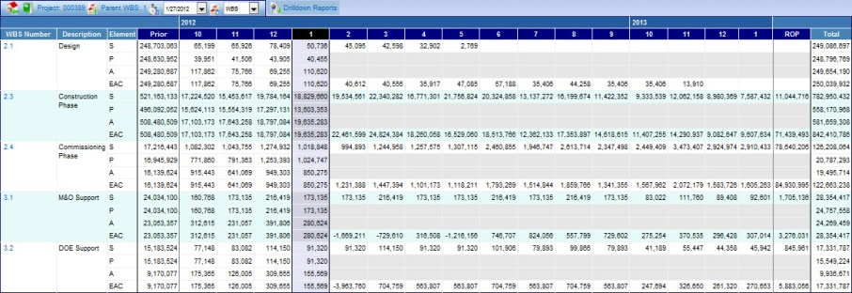
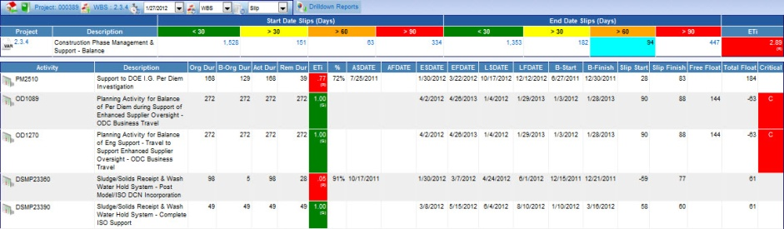
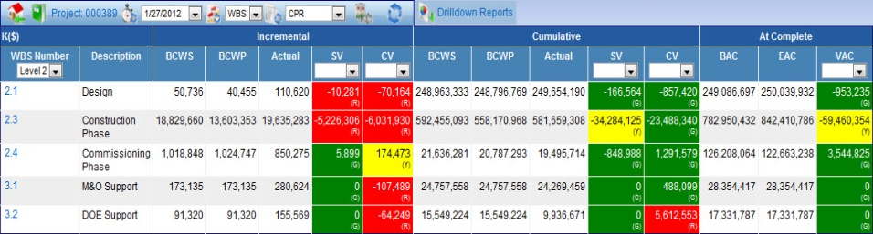
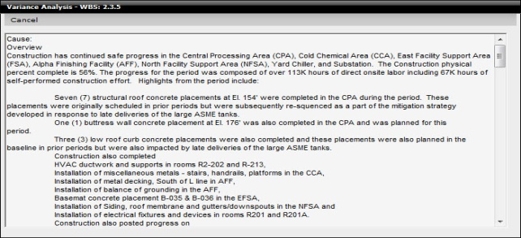
PARS II Dashboards
PARS II Dashboards
  CPR Dashboard
  Timephased Dashboard
  Schedule Dashboard
  Management Reserve (MR) Dashboard
Contractor Project Performance Data Uploads
  Dashboards only display data if CPP Data exists
Notes:
PARS II comes equipped with a series of project management dashboards that can be used by analysts to drill down into areas of interest. A Dashboard is defined as a drill-down view into the project management data displayed directly in a web browser from the Project Performance section of PARS II. Of course there are a plethora of possible reports that are serviced from PARS II data and displayed in Microsoft Excel. This report elaborates on the four (4) Dash-Board views used to analyze contractor performance based upon project management and EVM data uploaded into PARS II.
Dashboards are populated with data uploaded by the contractor through the CPP Upload Template. The PARS II requirement is for all Active Post-CD2 projects with Current Approved TPC of $20M and greater to conduct an upload of project costs and schedule data into PARS II. The following data elements are required for upload:
- Contractor status date for the performance period of the reported data (CPP Data As-Of Date)
- Project-level Information required for the Contract Performance Report (Format 1, 2, and 5)
- Project Work Breakdown Structure (WBS)
- Project Organizational Breakdown Structure (OBS)
- Incremental and Cumulative BCWS, BCWP, and ACWP for each reported WBS and OBS
- BAC, EAC, and ETC for each reported WBS and OBS
- Time phased BCWS, BCWP, ACWP, and ETC for each reported WBS and OBS
- Project Schedule Activity and Milestone data rolled up to the lowest reported WBS and OBS
- Project Schedule Activity Relationship data for each reported activity and milestone
- Management Reserve (MR) and Undistributed Budget (UB) balances in the current reporting period
- Management Reserve (MR) Log, including notes/comments for each transaction
- Variance Analysis Report (VAR) at each WBS or OBS at the appropriate reporting level for elements that breached a performance threshold

Slide 12
PARS II Assessment Roles
FPD Monthly Assessment: 3rd Business Day
  Explanation of Close Period Process
  BCP Impact on an FPD Assessment
PMSO Monthly Assessment: 6th Business Day
OECM Monthly Assessment: 9th Business Day

Slide 13
PARS II Assessments
Communicate project status to management and provide an informed prediction/forecast of project end state
  Don’t just report old news
  Predictions based on sound, documented analysis
Add Value
  Put the data in context for the SAE/AE
  Don’t wait until the peach is rotten
Report status of and progress addressing current technical/schedule risk areas and identification and mitigation of near term (future) risk areas

Slide 14
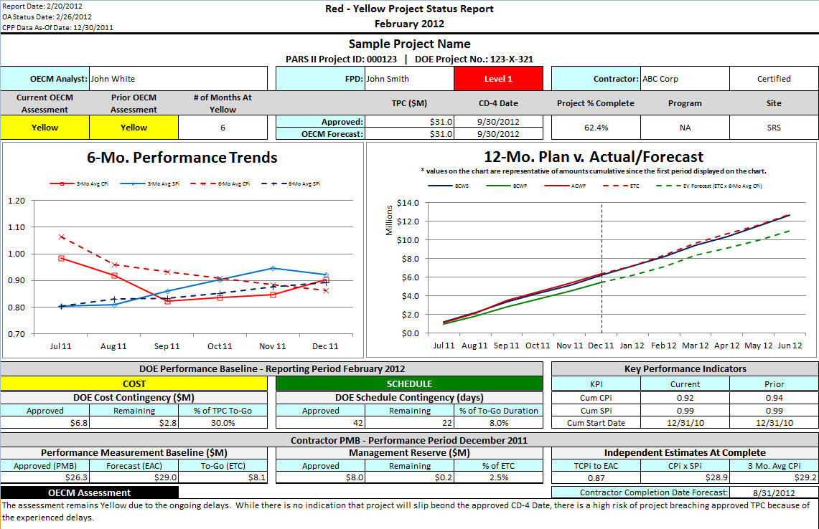
Sample Red/Yellow Project Report

Slide 15
Monthly Report Overview
Reasons for New Report Format
  Ability to Quickly Identify Changes from Prior Period Report
  Provide Greater Visibility into Project Performance
  Demonstrate Performance Trends
Report Content
  Updated Program Summary
  High-Level Changes from Prior Period Report
  Detailed Report for Each Red and Yellow Project
Notes:
In January of 2012 OECM released a new format of the DepSec Monthly Report. Major driver for the change in format were three things:
A need was identified to allow upper management to quickly see changes in Project Status from prior reporting period. Previous report required page-by-page comparison of prior and current reporting periods. The new report highlights those changes immediately.
Cumulative CPi and SPi data for Red and Yellow projects was masking true project performance. Greater detail and more visibility into project performance such as MR and Contingency burn rates, contractor-reported estimates, EAC validity data points were added to the new report.
3 and 6 month rolling average performance trends were added to demonstrate most recent contractor performance.
The new report contains updated program summary page, details of all the changes since last report, and by-project detail on red and yellow projects.

Slide 16
Request a Custom Report
What is the purpose of the report
What fields/information should be displayed on the report
  CD2 screen, FPD Assessment, etc.
  CD4: WHICH ONE?
What fields/information to be calculated on the report
(Proposed) Report Title
Report period
  Status Date, Current or Prior Period
Who are the Users of the report
Is this a new report, or a modification to an existing report
Note: All Custom Report requests should be coordinated with your Program.

Slide 17
PARS II Help Desk
The Helpdesk does not have the authority to change OA data within PARS II. Requests/Questions submitted are forwarded to OECM.
Password Reset
CPP Upload Issues
Workstation Configuration
Project Find/Search
The more information that you provide, the faster the issue can be resolved.
    The hours of operation for the PARS II Helpdesk are 8am-5PM, M-F.
    Email - I-Manage.Eas@hq.doe.gov
    301-903-2500 (option 4, then option 5)
    866-834-6246 (option 4, then option 5)

Slide 18
PARS II Information and Documentation
PARS II User Guide
  http://energy.gov/sites/prod/files/maprod/documents/PARS_II_User_Guide.pdf
PARS II SOP (Standard Operating Procedures)
  http://energy.gov/sites/prod/files/PARS_II_SOP_Version_1.1_2011_08_11.pdf
PARS II Change Request Form
  http://energy.gov/sites/prod/files/maprod/documents/PARS_II_Change_Request_Form.pdf
PARS II Training Schedule
  http://energy.gov/sites/prod/files/PARS_II_Training_Schedule_1.pdf
PARS II Training Course Registration
  http://energy.gov/management/pars-ii-course-registration

Slide 19
EVMS

Slide 20
What is an Earned Value Management System?
An integrated set of
    Documented Management Processes
    Management Information Systems
    Culture (People – Roles / Responsibilities)
Provides reliable and accurate project and program information
Used to support project management as a decision making tool and a critical component of risk management.
Notes:
EVMS consists of three high level components will be discussed in more detail on the next couple of slides:
Documented Management Processes - the documentation of how we accomplish the various steps in EVMS (the work definition, work authorization, baseline planning/scheduling, etc.)
Management Information Systems-scheduling software (such as MS Project, Primavera, Open Plan and others); cost processing software (such as MicroFrame Program Manager (MPM), Cobra, Cost View and others) and analytical software (such as wInsight).
People/Culture–the various roles and their importance in the EVMS concept – Program/Project Managers, Control Account Managers (CAMs), Integrated Product Teams (IPTs) and their leaders, Functional Managers, Program Control Analysts, Schedulers, etc.
Systems are necessary, but not sufficient; they only do four things: (1) collect data, (2) store data, (3) manipulate/slice & dice data, and (4) report data; point of which is GIGO

Slide 21
Certification and Surveillance Intent
The intent of an EVMS Certification/Surveillance process is to:
  Assess compliance of the EVM System with ANSI/EIA-748 across it’s applicable DOE Order 413.3B capital asset projects.
  Ensure implementation of the EVMS to monitor and manage cost, schedule, and technical performance across their entity.
  Assess maintenance and continued implementation of the EVMS.
  Provide a documented and defensible record for both DOE and the Contractor in support of any future Government Agency assessment of their EVMS or Order 413.3B compliance.
EVMS certification occurs after full completion of the review process
Notes:
Not only must the system be compliant with the standard, but we must verify that it is implemented and maintained across the project(s).
Documentation is a necessity to ensure we can provide a defensible record for not only DOE and the contractor, but also should either be subject to an outside review. Another reason for maintaining a record is if another Federal Civilian Agency expresses an interested in reciprocity.

Slide 22
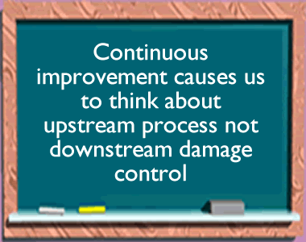
EVMS Surveillance – Why Change?
From:
  Re-certification Approach
  Every two years or at contract midpoint
To:
  Risk based, data driven
    Risk Matrix
    Portfolio focused
    Data sources include contractor self- assessments, project peer reviews, Integrated PARS II
Why would we want to change?
  Common Goal:
    Maximize results via continuous, real-time feedback and assistance; benefits all stakeholders
    Minimize surveillances costs by reducing on-site reviews and disruption to the projects
Based on Best Practices
Notes:
The DOE surveillance process differs from the certification process in that the certification review includes all guidelines from both a procedural and implementation perspective, and a portion of the review is conducted on site to observe integration of tools, conduct interviews, and interact with users. The DOE surveillance process will normally focus on areas identified as a result of risk and data analysis. Surveillance may be routine or situational as in an Implementation Review or RFC depending on the circumstances. Regardless of the purpose of review, i.e. routine surveillance, implementation, or RFC, the basic process of risk evaluation and data analysis is the same. The difference is that the scope, depth, and rigor may be tailored to suit the situation prompting the review.

Slide 23
So How Does This Affect You?
“Maximize results via continuous, real-time feedback and assistance; benefits all stakeholders”
Who are the stakeholders and how does this affect them?
  OECM
    Incorporates EVMS surveillance into their EV analysis roles
    Ties other types of reviews to EVMS surveillance
  PMSO
    Participates with OECM on surveillance review
    Can apply these principles to the PMSO-led reviews
  FPD and Project Controls
    Needs to understand how OECM conducts business as they support OECM during the reviews
    May elect to adopt same risk-based data-driven practices
    More bang for the buck; less disruption to the project
  Contractor
    The better they understand the process, the more smoothly the review goes
    They are responsible for internal surveillance and can adopt the same principles
    The new process is less disruptive to the contractor so they can focus on the task at hand
Notes:
OECM uses PARS II as a foundational tool in the surveillance process because that is where the EV data is and the reporting capability allow OECM to quickly analyze and focus in on the issues. Since FPDs are boots on the ground first line of defense with respect to EV data reliability, they need to be aware of how OECM is doing business now and that they can adopt the same approach...and if they do and do so effectively, OECM involvement in their lives can be significantly reduced. The other stakeholders are also involved – PMSO participates with OECM on surveillance reviews, and they also conduct their own surveillances for those portfolios with no project greater than $100M. The contractor is also a stakeholder as they are the ones being reviewed so process awareness is key, and they are also responsible for conducting internal surveillance and many of these methods would be helpful for them to apply.

Slide 24
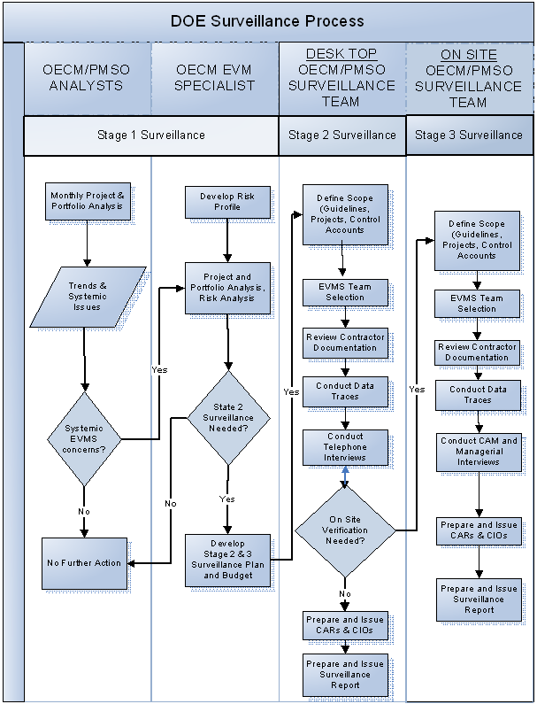
Notes:
The DOE surveillance process differs from the certification process in that the certification review includes all guidelines from both a procedural and implementation perspective, and a portion of the review is conducted on site to observe integration of tools, conduct interviews, and interact with users. The DOE surveillance process will normally focus on areas identified as a result of risk and data analysis. Surveillance may be routine or situational as in an Implementation Review or RFC. Regardless of the purpose of review, i.e. routine surveillance, implementation, or RFC, the basic process of risk evaluation and data analysis is the same. The difference is that the scope, depth, and rigor may be tailored to suit the situation prompting the review..
A recommended approach for EVMS surveillance is to conduct risk based, data driven continual surveillance. This may be done by conducting a risk assessment to identify areas of EVMS risk in each project, reviewing and analyzing EV data, and other artifacts including reports from recent project reviews. If the data or risk warrants a deeper look, then a desk audit may be conducted to gain more insight to include interviews with contractor and FPD staff, and review of additional supporting data requested from the contractor. Should areas of concern arise that cannot be sufficiently addressed off site, then an on-site review team may be assembled to focus on those remaining areas of concern.

Slide 25
Assessing System Risk
For EVMS Surveillance purposes:
  Recommended for all who are responsible for EVMS surveillance
  Look at results from portfolio perspective to determine where to focus surveillance efforts
Notes:
This is our first look at the Risk Matrix. It was introduced by NDIA and DCMA several years ago, and has been successful in application. OECM applies this to all projects within a contractor’s portfolio if one or more is over the $100M threshold assigned in DOE O 413.3B. OECM recommends the PMSO uses a similar approach for contractors with portfolios with one or more projects greater than $50M but none over $100M. And of course, this method is useful for all responsible for EVMS surveillance including contractors and FPD site offices.

Slide 26
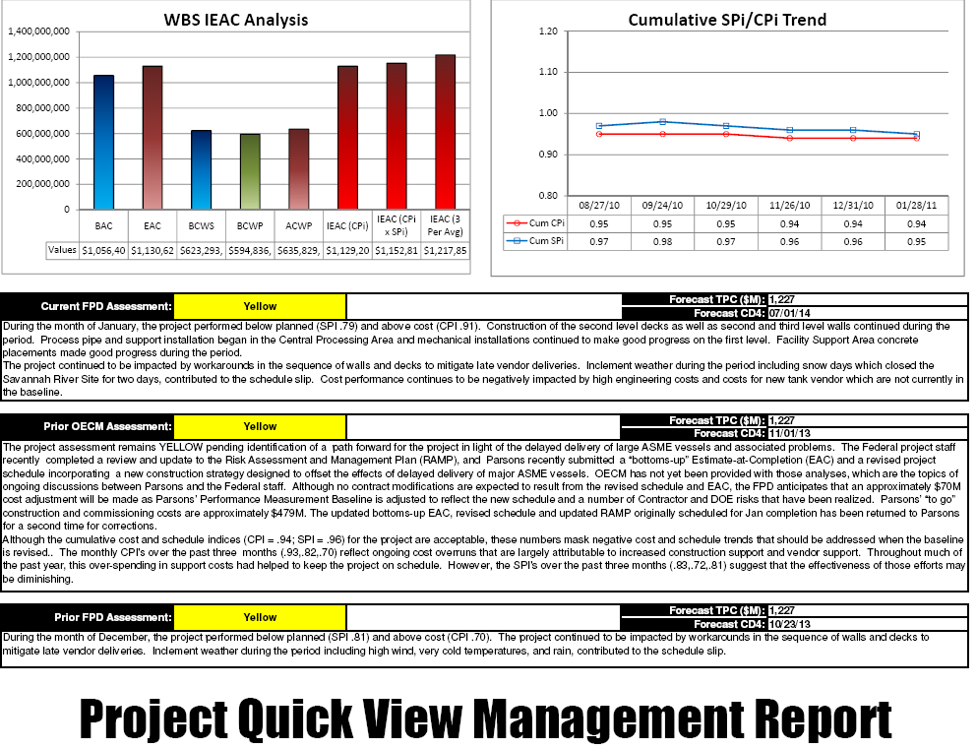
So What Data is Available?
PARS II has a wealth of information to begin the analysis process.
  Analysis folder under Reports
Period: | 02/25/2011 | 03/25/2011 | 04/29/2011
Cumulative to Date
BCWS | $659,657,596.03 | $684,942,413.03 | $713,196,217.79
BCWP | $659,862,983.14 | $683,547,978.06 | $705,571,573.85
ACWP | $652,688,718.46 | $678,517,746.82 | $699,719,987.07
SV | $205,387.11 | ($1,394,434.97) | ($7,624,643.94)
SV% | 0.03% | -0.20% | -1.07%
SPi | 1.000 | 0.998 | 0.989
CV | $7,174,264.68 | $5,030,231.24 | $5,851,586.78
CV% | 1.09% | 0.74% | 0.83%
CPi | 1.011 | 1.007 | 1.008
Current Period
BCWS | $36,364,214.15 | $25,284,817.00 | $28,253,804.76
BCWP | $65,026,378.23 | $23,684,994.92 | $22,023,595.79
ACWP | $16,859,675.33 | $25,829,028.36 | $21,202,240.25
SV | $28,662,164.08 | ($1,599,822.08) | ($6,230,208.97)
SV% | 78.82% | -6.33% | -22.05%
SPi | 1.788 | 0.937 | 0.779
CV | $48,166,702.90 | ($2,144,033.44) | $821,355.54
CV% | 74.07% | -9.05% | 3.73%
CPi | 3.857 | 0.917 | 1.039
At Complete
BAC | $1,202,539,560.15 | $1,202,539,560.15 | $1,202,539,558.84
EAC | $1,204,336,082.39 | $1,204,346,002.01 | $1,204,930,270.88
VAC | ($1,796,522.24) | ($1,806,441.86) | ($2,390,712.04)
ACi | 0.999 | 0.999 | 0.998
TCPi (To EAC) | 0.984 | 0.987 | 0.984
TCPi (To BAC) | 0.987 | 0.990 | 0.988
% Scheduled | 54.86% | 56.96% | 59.31%
% Complete | 54.87% | 56.84% | 58.67%
% Spent | 54.28% | 56.42% | 58.19%
IEAC
Cum CPi | $1,189,465,123.01 | $1,193,690,068.59 | $1,192,566,418.13
Cum SPi X Cum Cpi | $1,189,298,047.49 | $1,194,741,017.94 | $1,197,892,282.57
3 Period Moving Average | $957,384,034.24 | $967,161,086.04 | $986,456,453.18
Notes:
Go to the Analysis folder in the reports section of PARS II to find the primary data you will need to get started. The information available to assist the analyst will be discussed in the Analysis module of this training.

Slide 27

PARS II Baseline Volatility
For risk purposes, use this to determine both baseline volatility and current period changes.
Notes:
The PARS II Baseline Volatility report takes the end of period baseline plan for the last 12 month period and calculates an average percent change of PMB over a six month period.
In second calculation, if the value is negative, then BCWS is moved forward (later in the project). If BCWS is positive, then work is being moved sooner, to be done earlier than planned.

Slide 28
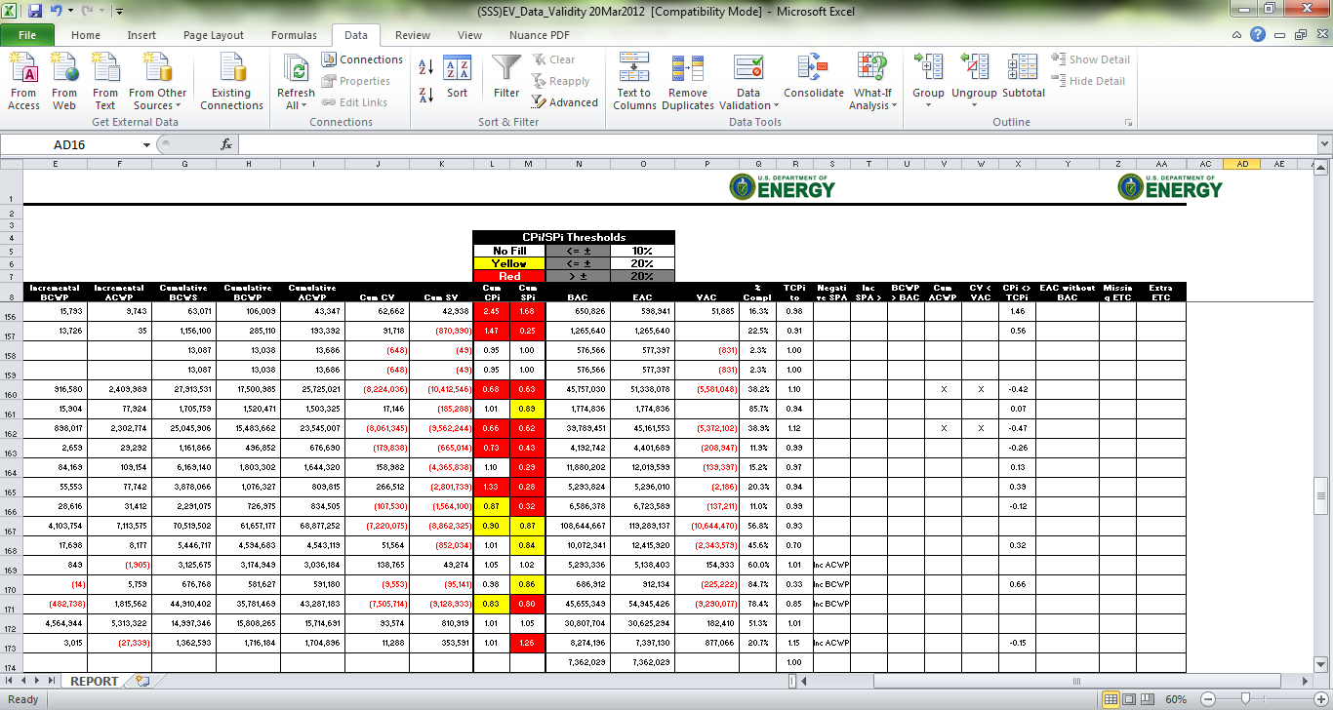
PARS II Data Validity Report
For risk purposes, consider how valid the data has been since the last review.
Notes:
The PARS II Baseline Volatility report takes the end of period baseline plan for the last 12 month period and calculates an average percent change of PMB over a six month period.
In second calculation, if the value is negative, then BCWS is moved forward (later in the project). If BCWS is positive, then work is being moved sooner, to be done earlier than planned.

Slide 29
PARS II Project Summary Report
For risk purposes, determine SV%, CV%, and VAC%.
Notes:
The PARS II Baseline Volatility report takes the end of period baseline plan for the last 12 month period and calculates an average percent change of PMB over a six month period.
In second calculation, if the value is negative, then BCWS is moved forward (later in the project). If BCWS is positive, then work is being moved sooner, to be done earlier than planned.

Slide 30

EV Data Analysis
Validity check of data
Analyze variances
Analyze trends
Assess realism of contractor’s EAC
Predict future performance and an IEAC

Slide 31
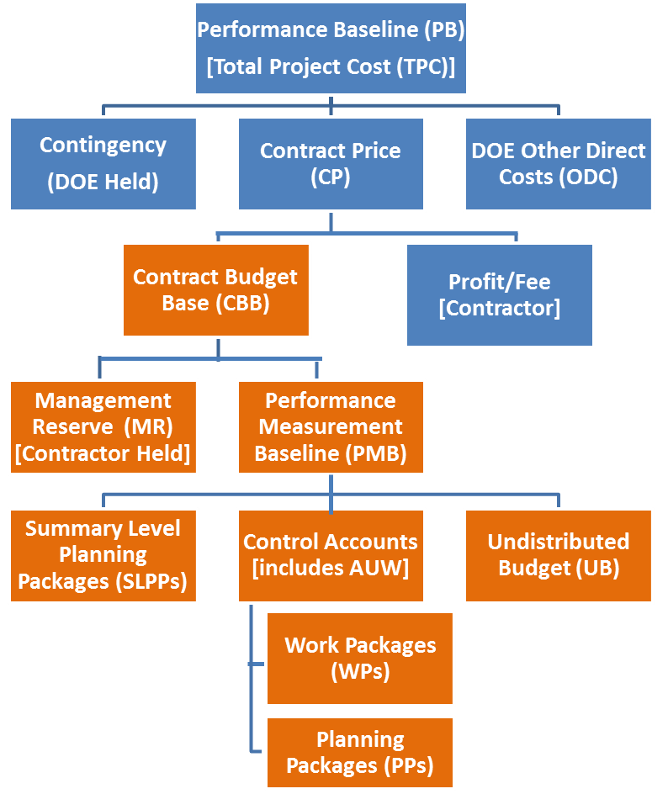
Compare Contractor’s EAC with
the Statistical IEACs; Consider Impact to TPC
    Given the EAC range, is the contingency sufficient to cover projected overruns without breaching the TPC?
Notes:
You can find this report at PARS II Report – Analysis Folder, WBS IEAC Analysis. The contractor’s EAC appears reasonable based on range from the three independent EACs. When overruns are forecast, consider the relationship of any variances at completion to the remaining Contingency.

Slide 32


Budget vs. Funds: The Difference
Budget cannot be spent.
It can only be used for measurement purposes.
It is a metric.
vs.
Funds are real dollars being spent and those real dollars forecasted to be spent.
So what’s the difference between MR and Contingency?

Slide 33

Management Reserve and Contingency Usage
Period 1
Period 2
Period 3
Period 4
Period 5
Period 6
Cost Variance
Customer Contingency
Variance at Completion
Contractor Management Reserve*
Project
Scope
Authorized Funding
CBB
EAC
PMB
*Represents an MR forecast in the Most Likely EAC
Notes:
Or the DOE could decide to pursue a fix to the problem, maintain the scope, and use their remaining contingency. In this case the program would decide that the other two sides of the triangle are too important to impact, and they would make the decision to allow the cost impact. This doesn’t change the contract value (CBB) since it’s only a funding increase, but it does require the customer to change the funding authorization to match the increase in EAC. The Contingency is gone as is any flexibility for the DOE customer to make additional program adjustments.

Slide 34
Common EVMS Compliance Issues
EVMS Description
Control Accounts
Work Packages/Discrete Tasks
Estimate At Completion
Baseline Change Control
Subcontract management
Schedule Integration Issues

