Slide 1

EM Update and Perspective
David Huizenga
Senior Advisor for Environmental Management
2012 DOE Project Management Workshop
April 3, 2012

Slide 2
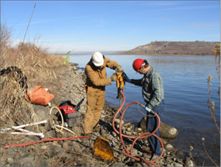
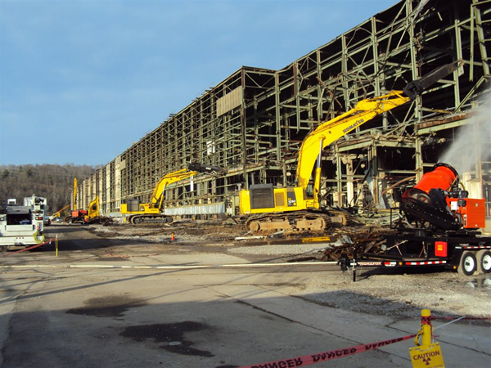
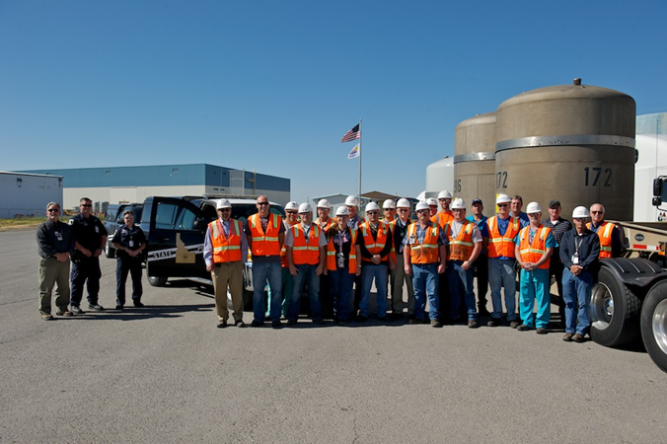
EM Mission
“Complete the safe cleanup of the environmental legacy brought about from five decades of nuclear weapons development, production, and Government-sponsored nuclear energy research”
From a legacy of weapons production to the world’s largest environmental cleanup program
Operating in the world’s most complex regulatory environment
EM clean-up enables DOE to maintain ongoing operations and other critical missions (NNSA/SC) while achieving compliance with governing environmental laws

Slide 3
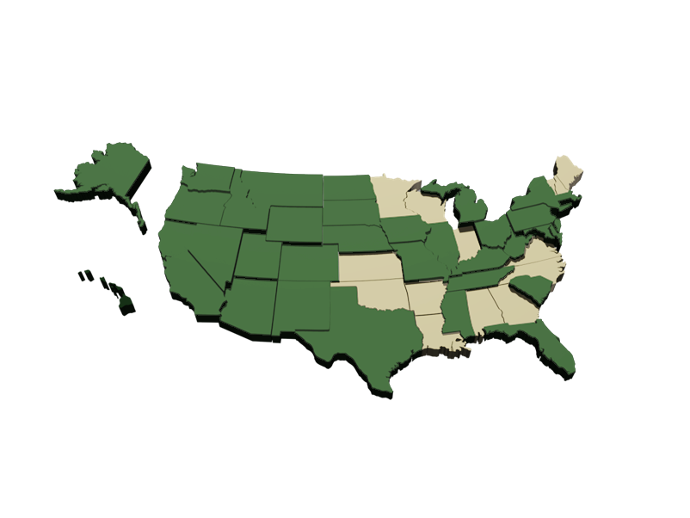
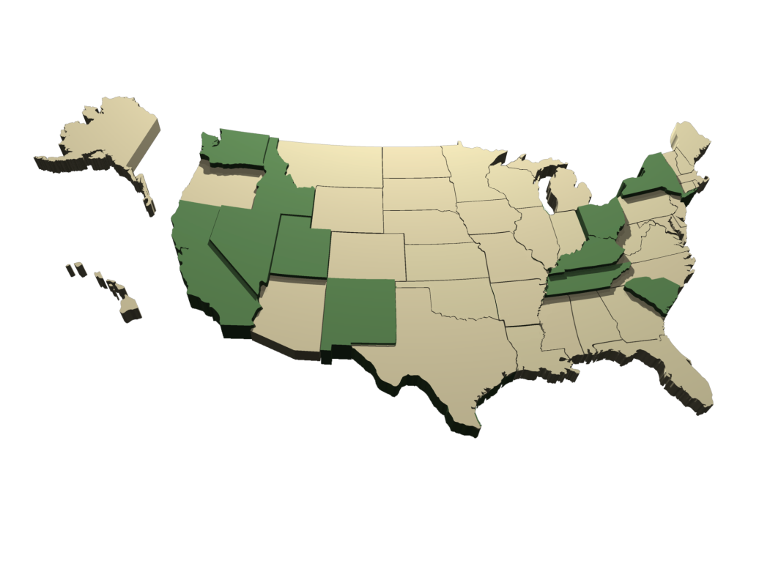
Progress to Date and Challenges Ahead
1989: Start of EM Cleanup
107 sites
35 states
3,125 sq. miles
End of 2011
17 sites
11 states
318 sq. miles
Significant challenges remain ahead, including completion of liquid tank waste construction projects and deactivation and decommissioning of a large number of facilities
These challenges require innovative technical and scientific solutions and effective project management

Slide 4
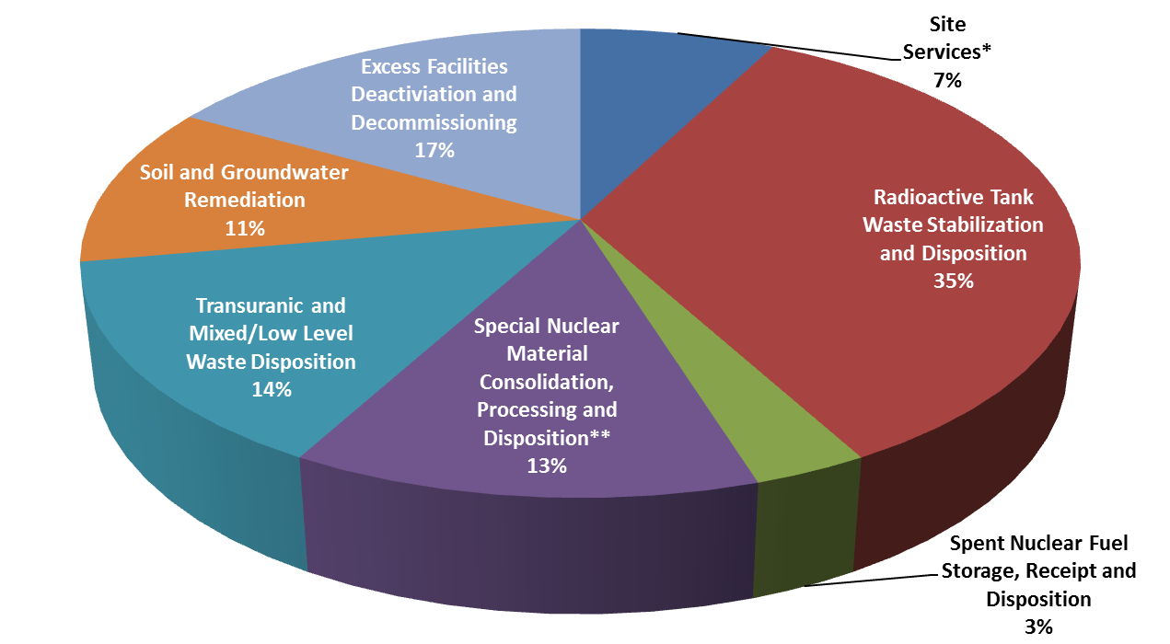
EM Program Priorities
Maintain a safe, secure, and compliant posture in the EM complex
Radioactive tank waste stabilization, treatment, and disposal
Spent (used) nuclear fuel storage, receipt, and disposition
Special nuclear material consolidation, processing, and disposition
Transuranic and mixed/low-level waste disposition
Soil and groundwater remediation
Excess facilities deactivation and decommissioning (D&D)
FY 2013 Budget Request - $5.65B
$950M
$428M
$1,958M
$631M
$805M
$722M
$177M
* Includes Program Direction, Program Support, TDD, Post Closure Administration and Community and Regulatory Support
** Includes Safeguards and Security

Slide 5
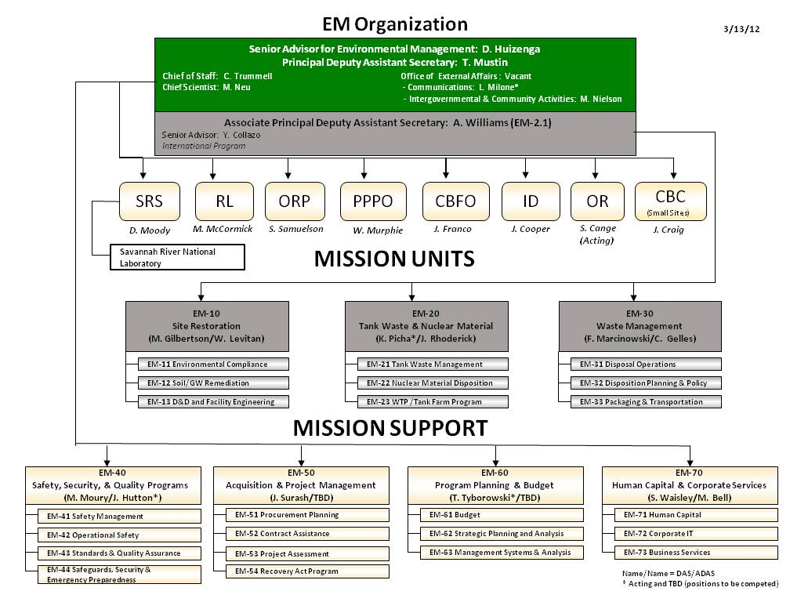
EM Organization

Slide 6
EM Reorganization
New EM organization is aligned to better support programmatic priorities and improve mission execution
Business model is based on a matrix construct
  Facilitate collaborative decision-making around shared goals
  Clarify roles, responsibilities, authority, and accountability with the Field and within HQ, and to support continuous improvement
Roles and responsibilities under DOE Order 413.3B
  Mission Units have Program Management authority
  Office of Project Assessment (EM-53) serves as the Project Management Support Organization (PMSO)
  Field Managers retain Acquisition Executive authority for projects with Total Project Cost less than $100 million

Slide 7
EM Capital Asset Project Portfolio Overview
Line Item Construction Projects (post-CD2/3)
  Waste Treatment and Immobilization Project (WTP) - $12.3 B TPC
  Salt Waste Processing Facility (SWPF) - $1.3 B TPC
  Sodium Bearing Waste Treatment (SBWT) - $571 M TPC
23 EM Cleanup Projects (post-CD2/3) – $7.1 B combined TPC
  Waste Disposition
  Soil and Groundwater Remediation
  D&D
9 Active Pre-CD2 Projects
Cleanup
Projects
$946 M
WTP
$903 M
Other Line Items
$355 M

Slide 8
EM Cleanup Project Success
Cleanup Projects Completed | Cost Success | Schedule Success | Combined Original Approved TPC | Combined Actual Cost at Completion
34 | 32 (94%) | 32 (94%) | $1,040 M | $820 M (21% less)
From the start of the DOE Root Cause Analysis (RCA) Corrective Action Plan in 2008 through the end of FY 2011:
EM completed 34 cleanup projects (25 for ARRA) and 1 line item project
32 of 34 (94%) cleanup projects met the RCA cost success metric - within 110% of original approved CD-2 cost
Actual costs at completion of $820 M compared to $1,040 M original approved TPC (21% under TPC)
32 of 34 (94%) also met the RCA schedule metric for project completion

Slide 9
FY 2012 capital project progress to support EM’s cleanup mission
EM completing 17 projects
Richland
4
West Valley
1
Idaho
2
Argonne
1
Brookhaven
1
Paducah1
Oak Ridge
4
Savannah River
3
  Tank Waste:
    Achieve CD4 and start operations for Sodium Bearing Waste Treatment
    Progress on Waste Treatment Plant & Salt Waste Processing Facility
  Excess Facilities:
    Complete 14 D&D projects at 8 sites
  Waste Disposition / Soil and Groundwater:
    Achieve CD4 on two waste disposition projects to expand capacity
    Complete physical work on two projects remediating contaminated sites
Notes:
Sodium Bearing Waste Treatment Facility – Construction is complete and operational startup is planned in 2012.
Salt Waste Processing Facility – Construction is over 70% complete with operational startup planned in FY 2016.

Slide 10
EM Hot Topics
EM’s Utilization of Traditional Contracts
Looking for Opportunities to Shift Risk to Contractor
Keeping Contract and Project Baselines Aligned through timely Contract and Project Change Control
Continuing to Use of EM Partnering Policy
Continuing to Improve Peer Reviews

Slide 11
EM Program Goals & Achievements
Goal 1:
Improve safety and quality performance
Goal 2:
Reduce the life cycle cost and risks of the nuclear legacy cleanup
Goal 3:
Improvement of project, budget, and contract management
Goal 5:
Execute the EM Mission in a sustainable manner
Goal 4:
Achieve excellence in management and leadership

Slide 12
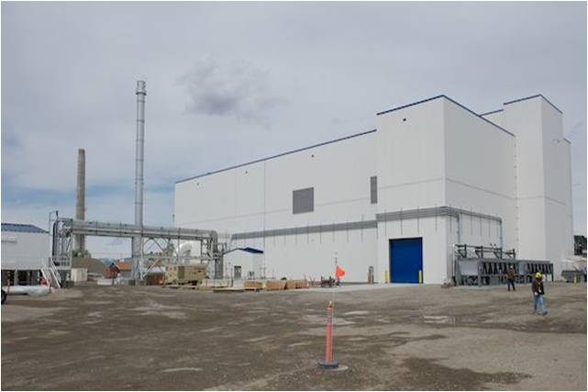
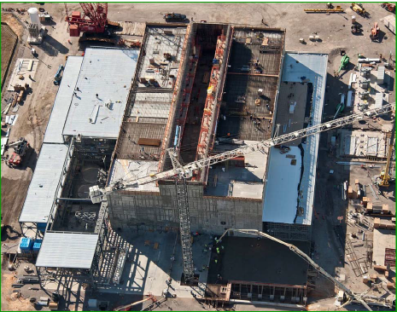
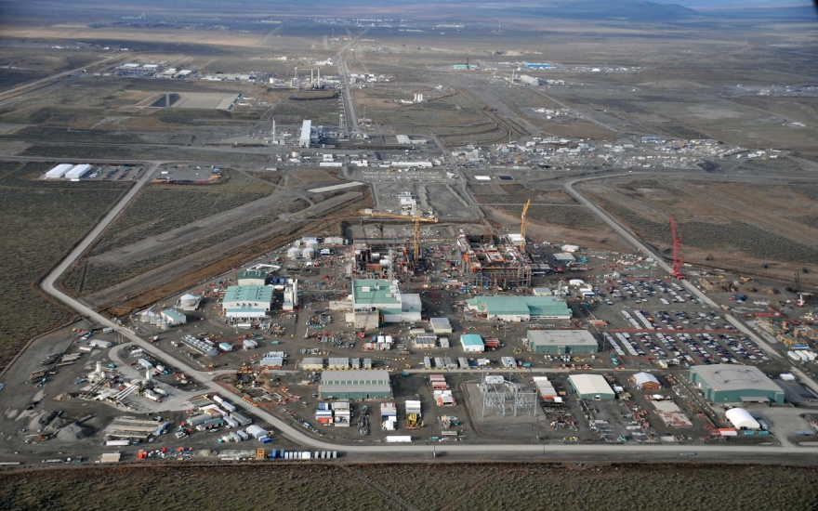
Supporting Goal 2: Complete the three major tank
waste treatment construction projects
Sodium Bearing Waste Facility
Construction complete 2011 (operational 2012)
Salt Waste Processing Facility
Construction complete 2015 (operational 2016)
Waste Treatment Plant
Construction complete 2016 (operational 2019)

Slide 13
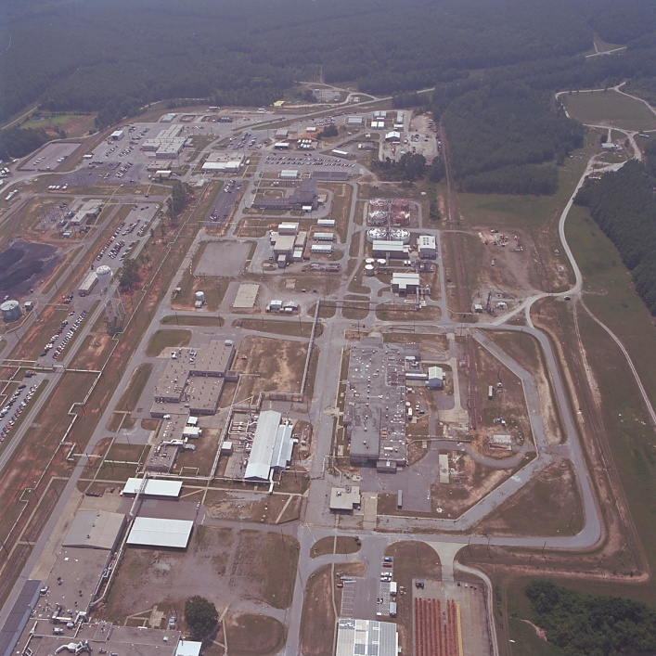
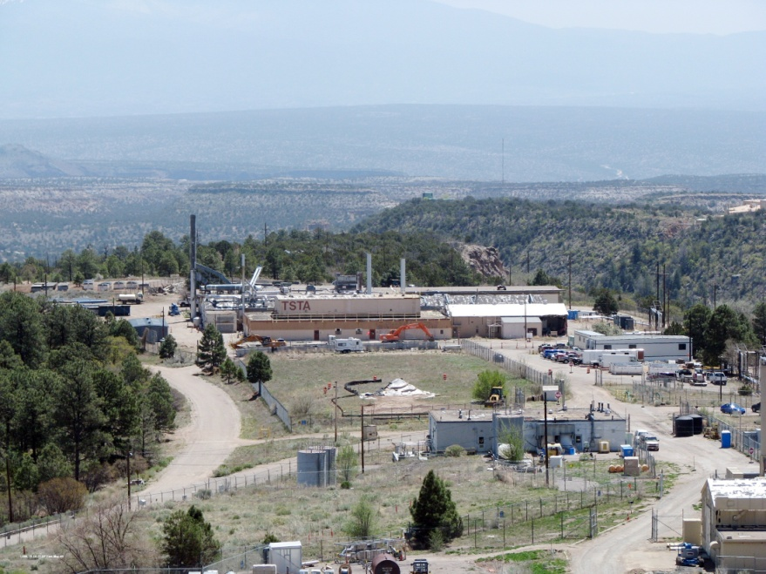
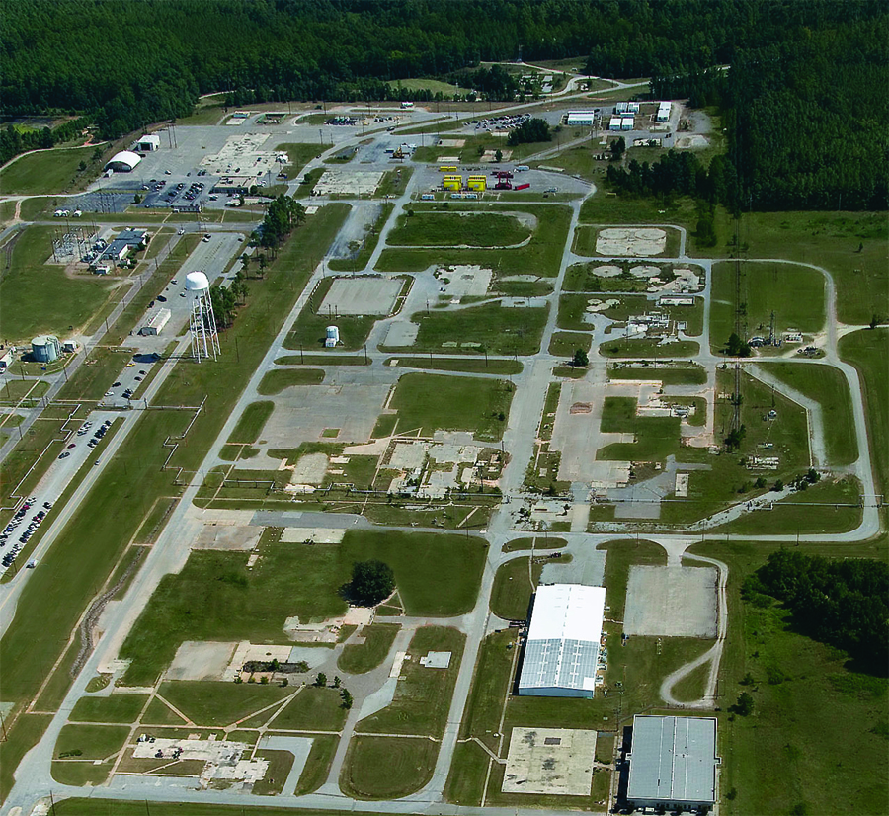
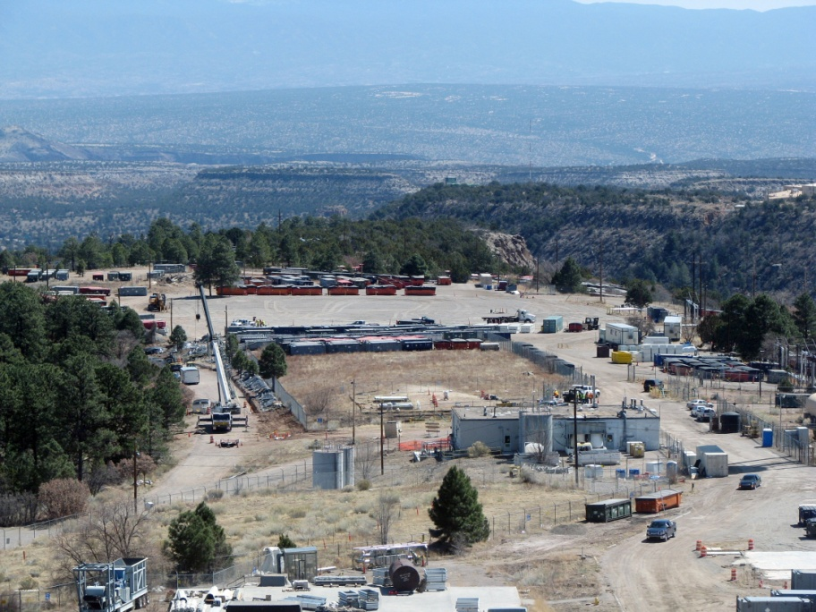
Supporting Goal 2: Reduce the EM Legacy Footprint
Before:
Savannah River
M Area
Before: LANL TA-21
After: LANL TA-21
After: Savannah River
M Area

Slide 14
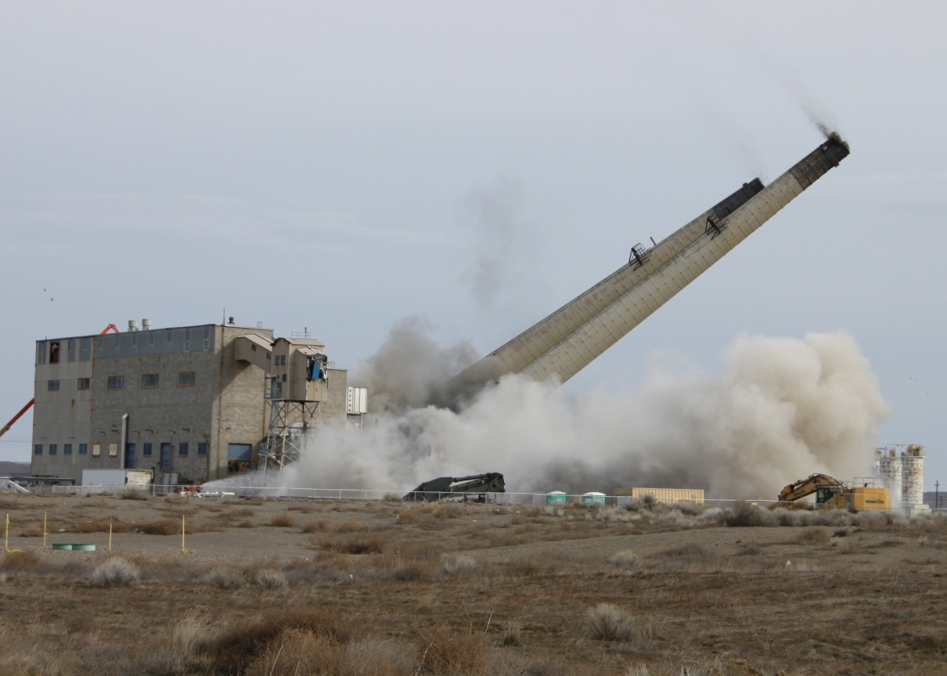
Supporting Goal 3: Continuous improvement of project, budget, and contract management
  Delivering results on time, within cost, and with world-class technical competencies.
EM continues to take measures to improve its management of budget, contracts and project management to ensure project performance.
  Contracting Summit
  Complex-wide strategic planning analysis

Slide 15
Supporting Goal 3: Contract, budget, and project management - key strategies
Validate the effectiveness and sustainability of previous corrective measures.
Sustain needed capacity for contract and project management staffing and skills.
Expand the use of independent contract and project reviews.
Strengthen integration of contract, budget and project management.
Become a stronger owner by holding contractors accountable and pursue partnering relationships.
Develop EM-specific cost estimating capabilities to improve Independent Government Cost Estimates and Cost Reviews.

Slide 16
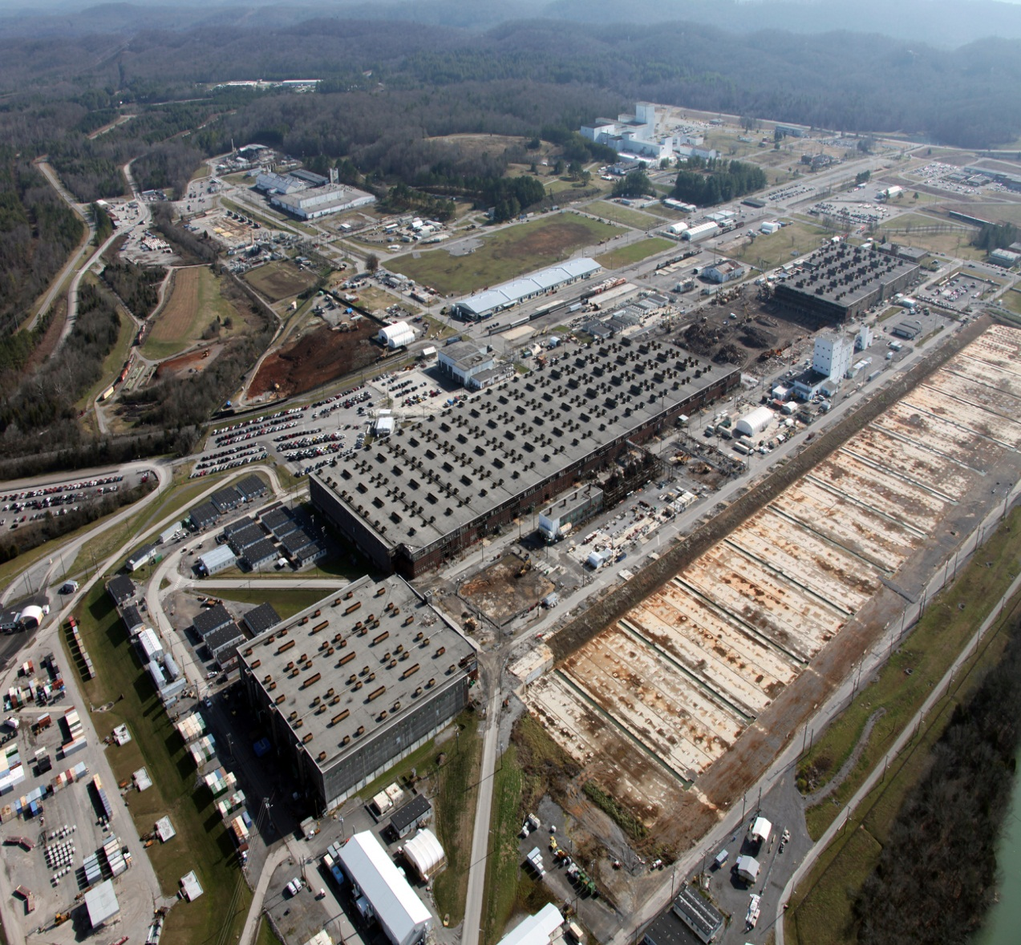
EM: A National Responsibility
Time is not on our side – costs and risks increase over time.
We have a responsibility to relieve future generations of this environmental and financial liability.
We have delivered significant cleanup results in the past several years, while completing projects on time and within cost

