Slide 1
IGCA Inventory Data Collection Tool Training
2012

Slide 2
Objective
The purpose of this training is to familiarize you with:
Defining Inherently Governmental (IG) functions for the 2012 Inherently Governmental and Commercial Activities (IGCA) Inventory (starting page 3), and
The Excel spreadsheet provided for the 2012 IGCA Inventory. The collection tool enables the user to see side by side previous and current year data – allowing an “apples to apples” comparison (starting page 13)

Slide 3
Defining Functions as IG or Commercial
Coding functions as IG or commercial requires substantial discretion. The goal of this training is to encourage a consistent coding methodology throughout DOE by providing examples of IG and commercial activities
The Office of Federal Procurement Policy (OFPP) has recently issued OFPP Letter 11-01, Performance of Inherently Governmental and Critical Functions.

Slide 4
Formal Definition of IG
‘‘Inherently governmental function,’’ as defined in section 5 of the Federal Activities Inventory Reform Act, Public Law 105–270, means a function that is so intimately related to the public interest as to require performance by Federal Government employees.

Slide 5
Tests for Identifying IG Functions
The nature of the function. Examples include:
  Officially representing the United States in an inter-governmental forum or body
  Arresting a person
  Sentencing a person convicted of a crime to prison
The exercise of discretion. Examples include:
  Commits the government to a course of action where two or more alternative courses of action exist
  decision making is not already limited or guided by existing policies, procedures, directions, orders, and other guidance

Slide 6
Inherently Governmental –
Human Resource Examples
Human Resources Activities:
  Selection, or non-selection, of individuals for federal employment
  Approval of position descriptions/performance standards for federal employees
  Directing and controlling federal employees
Example positions:
  Supervisory positions, because they exercise discretion in applying government authority and have authority to select individuals for employment, and control and direct federal employees
  Positions involving providing labor relations services because of the discretion they may exercise in negotiating contracts and in representing the agency in third party litigation
  Positions that include the authority to certify appointments, providing the “Oath of Allegiance to the United States” for newly hired employees, and classifying positions

Slide 7
Inherently Governmental –
Budget Examples
Budget Activities:
  Exerting ultimate control over the acquisition, use, or disposition of the property, real or personal, tangible or intangible, of the United States, including the collection, control, or disbursement of appropriated and other federal funds
  Determining federal program priorities or budget requests
  Determining budget policy, guidance, and strategy

Slide 8
Inherently Governmental – Administrative Examples
Administrative Activities:
  Determining what government property is to be disposed of and on what terms
  Determining what supplies or services are to be acquired
  Participating as a voting member on source selection boards
  Approval of any contractual documents
  Approving agency responses to Freedom of Information Act requests
  Approving federal licensing actions and inspections
  Conducting administrative hearings to determine the eligibility of any person for a security clearance
Example Positions:
  Procuring contracting officers holding a contracting warrant
  Federal property managers responsible for the decision to acquire or dispose of U.S. property. This does not include purchase card holders that purchase from a predetermined list of vendors

Slide 9
Inherently Governmental –
Other Examples
Legal Activities:
  Determining, protecting, and advancing U.S. economic, political, territorial, property, or other interests by civil or criminal judicial proceedings
Policy Making Activities:
  The determination of agency policy, such as determining the content and application of regulations, among other things
Inspections/Investigations:
  The direct conduct of criminal investigations
  The control of prosecutions and performance of adjudicatory functions (other than those relating to arbitration or other methods of alternative dispute resolution)
Note – Such functions/positions are generally at a headquarters level

Slide 10
Defining Commercial Functions
A commercial function involves a recurring service that could be performed by the private sector and is resourced, performed, and controlled by the agency through performance by government personnel, a contract, or a fee-for-service agreement
Commercial functions may be found within, or throughout, organizations that perform inherently governmental functions or classified work

Slide 11
Examples of Commercial Functions
Budget, management, and program analysis work including cost analysis, workload modeling, manpower and equipment requirements determination, operational audit, efficiency reviews, and fact-finding
Conducting reorganization and planning functions
Analyses, feasibility studies, and strategy options to be used by agency personnel in developing policy
Development of regulations
Support of acquisition planning
Financial management transactional work such as invoice payment processing
Transacting certain human resources administrative actions such as processing SF-50 Notification of Personnel Actions, and maintaining official personnel folders
Assistance in the development of performance work statements and statements of work
Supporting preparation of responses to Freedom of Information Act requests
Providing information regarding agency policies or regulations, such as attending conferences on behalf of an agency, conducting community relations campaigns, or conducting agency training courses

Slide 12
IGCA Tool
WALKTHROUGH
The next section reviews the functionality of the IGCA Tool (spreadsheet), and the process of filling out this year’s data collection

Slide 13
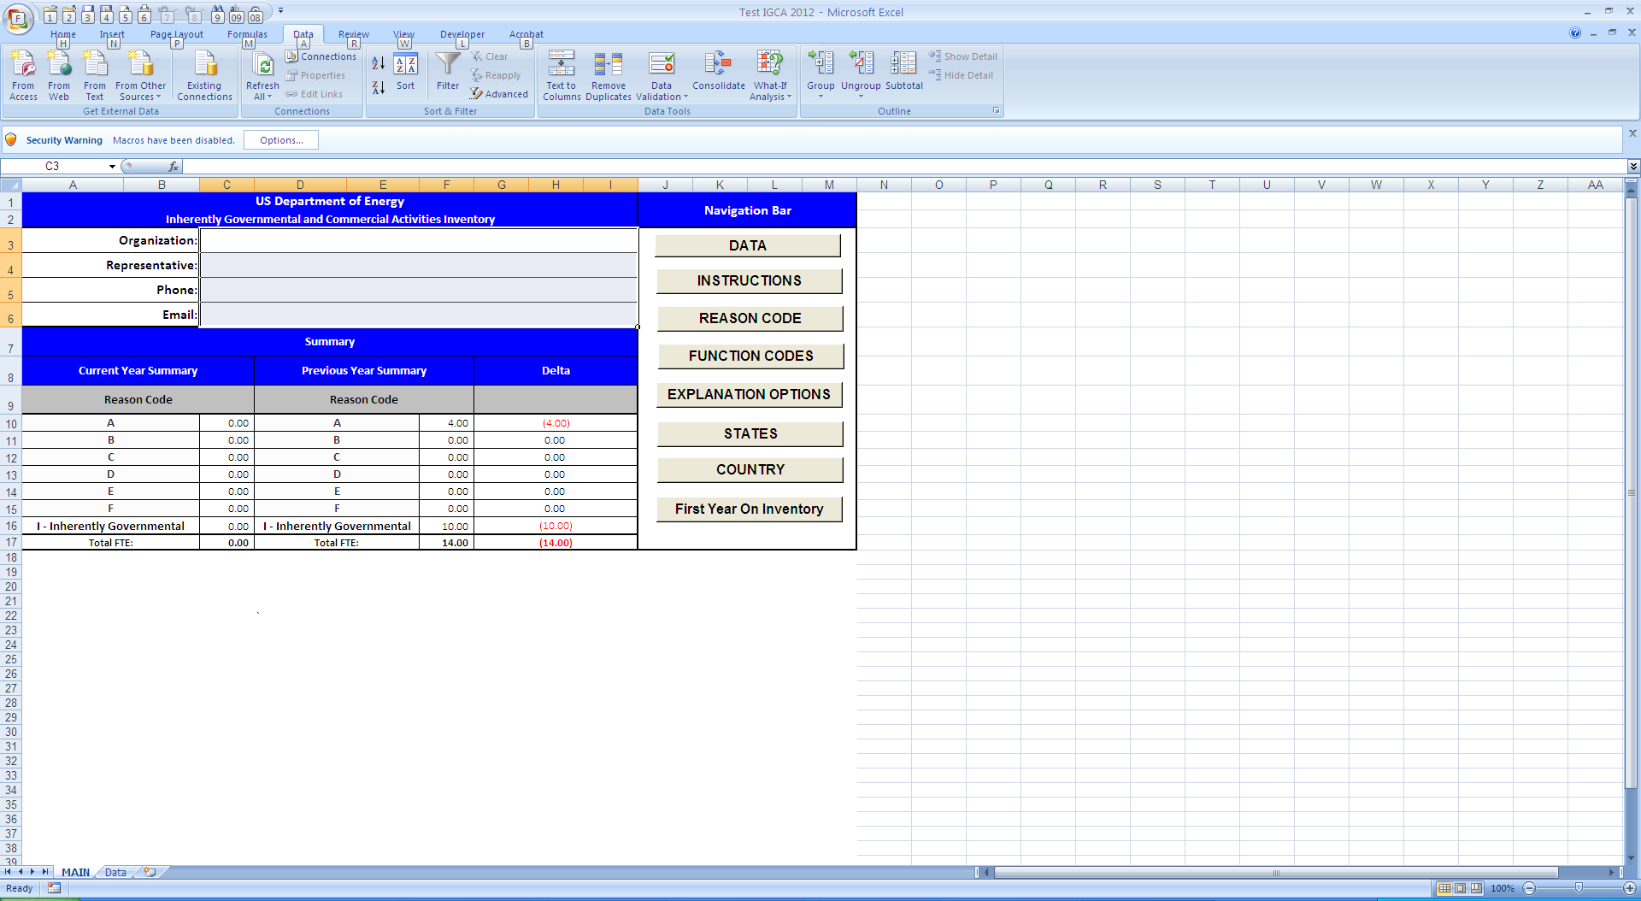
Open the Spreadsheet
Because it contains macros, you will see this window when opening the spreadsheet
Select “Options” then “Enable This Content” when this window appears

Slide 14
MAIN Spreadsheet
Includes a navigation bar with options to view additional information, including instructions and the different drop down menu options
Provides an automated summary / comparison of your previous and current year data

Slide 15
MAIN Spreadsheet cont…
To view and update previous year data click on
To view the submission instructions for the IGCA Inventory data collection, click on
To view the available Reason and Function codes, and their definitions, click on

Slide 16
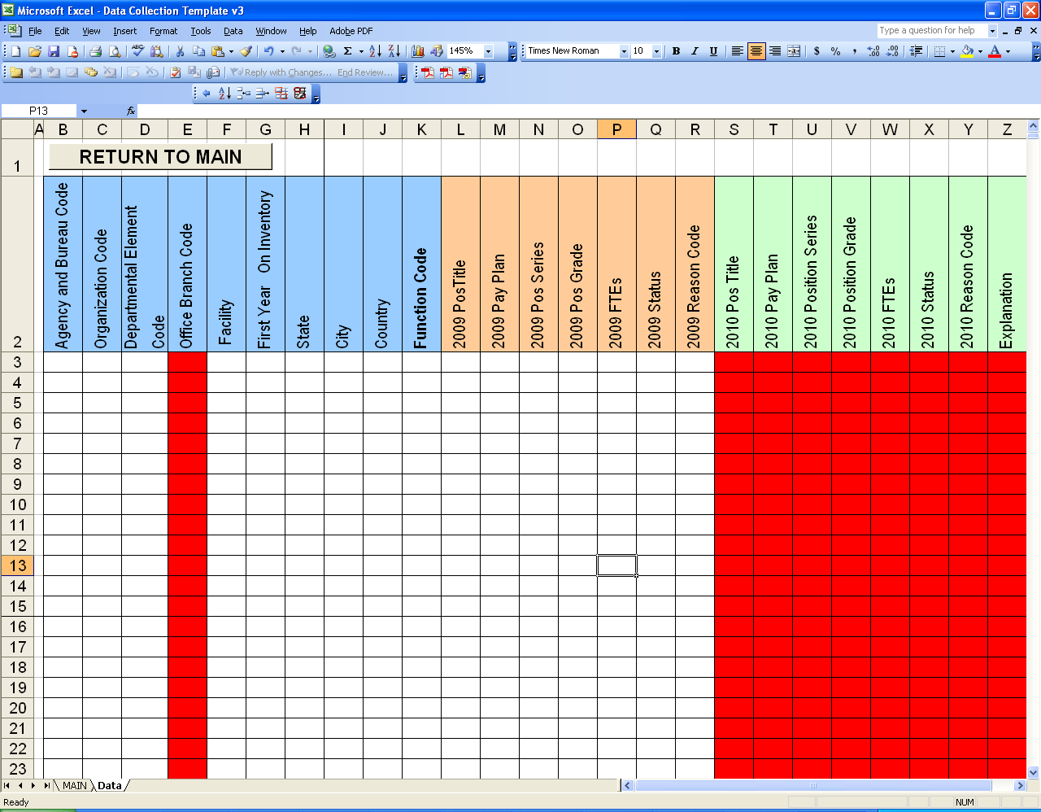
Data Spreadsheet
Data Groups
Group 1
Blue - General Data
Agency and Bureau Code
Organization Code
Departmental Element Code
Office Branch Code
Facility
First Year on Inventory
State
City
Country
Function Code
Group 2
Orange - Previous Year Data
2011 Pos Title
2011 Pay Plan
2011 Pos Series
2011 Pos Grade
2011 FTEs
2011 Status
2011 Reason Code
Group 3
Green - Current Year Data
2012 Pos Title
2012 Pay Plan
2012 Pos Series
2012 Pos Grade
2012 FTEs
2012 Status
2012 Reason Code
Explanation

Slide 17
Data Entry
The Tool includes data from last year as a starting point
NOTES:
On several of the data entry cells, you are limited to a specified response. These include First Year On Inventory, State, Country, Function Code, Status, Reason Code, and Explanation. You must select from the drop down list for those limited responses.
All fields must be completed. Blank cells begin with a Red background, so you can easily identify which areas still need to be filled in. The Red background goes away once information is entered into the cell
Instructions:
If data has not changed between 2011 and 2012 - copy 2011 data (Group 2) and paste on 2012 data fields (Group 3). Under the “Explanation” column please select:
    No Change

Slide 18
Data Entry cont…
2. If data in (Group 1) and/or (Group 2) has changed - update data on (Group 1) and (Group 3). Under the “Explanation” column please select one of the following:
    Reason Code Change
    More FTEs
    Less FTEs
    Other
If you need to add new entries – input new data in (Group 1) and (Group 3) at the bottom of the spreadsheet. Under the “Explanation” column please select:
    New Entry
  Make sure that under (Group 2), which corresponds to FY 2011 data, you input N/A on every cell
If previous year data is non-existent in FY 2012, input N/A in (Group 3) cells. Under the “Explanation” column please select:
    Non-existent in 2012

Slide 19
Data Entry cont…
The following table provides the list of possible Explanations available.
Reason Code Change | If during this fiscal year the function has been classified with a different reason code please select this option. This could be the result of a reorganization or management decision.
Function Code Change | If during this fiscal year the function has been classified with a different function code please select this option. This could be the result of a reorganization or management decision.
No Change | If there has been no change please select this option.
More FTEs | If the function includes more FTEs please select this option.
Less FTEs | If the function includes less FTEs please select this option.
New Entry | If the function is new to your organization please select this option. Keep in mind that you must include the current year in the 'First year on Inventory' column. A new entry could be derived from a. If the new entry belonged to a different organization on the previous fiscal year, please coordinate with the respective organization so that the FTE is not accounted for twice.
Non-existing | If the function no longer exists within your organization please use this option. If the function was eliminated due to reorganization please select this option. If the function was inherited by a different organization please coordinate with the respective organization so that the FTE is not accounted for twice.
Other | If the change is not described by any of the above options please use this option.

Slide 20
Point of Contact
If you have any questions on how to use the Excel spreadsheet contact Jeff Davis at (202) 287-1877 or by e-mail at Jeff.Davis@hq.doe.gov
After you have entered and verified your data please submit to:
Jeff Davis, Jeff.Davis@hq.doe.gov

