Slide 1
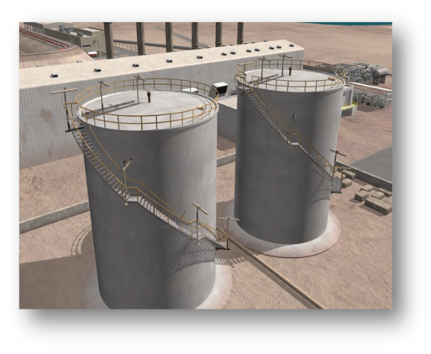
FY 2015 Budget Request Office of Fossil Energy
Julio Friedmann Deputy Assistant Secretary for Clean Coal
Office of Fossil Energy
March 4, 2014

Slide 2
Meeting the President’s Energy Goals
“The all-of-the-above energy strategy I announced a few years ago is working, and today, America is closer to energy independence than we’ve been in decades.”
President Barack Obama State of the Union Address January 28, 2014
Photo courtesy of the White House, Pete Souza

Slide 3
Meeting DOE’s Mission
Transform Our Energy Systems
Cost-competitive development of carbon capture and storage (CCS) technology
Science & Engineering Enterprise
Technology innovations that enable fossil fuels to continue to be part of a diversified, low-carbon energy portfolio
Management & Operational Excellence
Secure Our Nation
FE-wide business review assessment for sustainable, cost-effective mission success
Graduate and post-graduate research and internship support
Environmentally sustainable and safe development of unconventional oil and gas resources
International partnerships for clean energy deployment
Advanced modeling and simulation to reduce upfront cost, risk of CCS
Demonstration of commercial-scale CCS projects
Strategic Petroleum Reserve provides a Federal emergency response to domestic & international oil disruptions.
Northeast Home Heating Oil provides protection of the NE from winter shortages.

Slide 4
Fossil Energy Budget Highlights
Request
FY2015
(Dollars in Thousands)
CCS Demonstrations Natural Gas Carbon Capture & Storage
CCS & Power Systems
Carbon Capture Carbon Storage Advanced Energy Systems Cross-cutting Research
NETL Coal R&D Total CCS & Power Systems Oil & Natural Gas Technologies
25,000
77,000 80,084
51,000
35,292
34,031
$302,407 $35,000
Research
and
Development
Other R&D/Prog. Direction/Mgmt.Support
$138,093
Total, Research and Development
$475,500
Rescission of CCT Prior Year Funds
($6,600)
Petroleum
Reserves
Strategic Petroleum Reserve
Northeast Home Heating Oil Reserve*
Naval Petroleum Reserves/RMOTC
Elk Hills School Land Fund
$205,000
1,600
19,950
15,580
Total Fossil Energy Budget
$711,030
*Northeast Home Heating Oil Reserve FY 15 budget includes the use of $6M in prior year balances bringing it to a total of $7.6M.

Slide 5
Advancing Coal Toward a Low-Carbon Future
CCS Demonstrations (funded in large part through Recovery Act)
Clean Coal Power Initiative
FutureGen 2.0
Industrial CCS
Natural Gas Carbon Capture & Storage
Carbon Capture & Storage and Power Systems Program
Carbon Capture
Carbon Storage
Advanced Energy Systems
Cross-cutting Research

Slide 6
CCS Demonstrations
Subprogram is focused on reducing greenhouse gas emissions by boosting plant efficiencies and capturing and storing CO₂
FY 2015 Request: $25.0 Million
Natural Gas Carbon Capture
(25.0 Million)

Slide 7
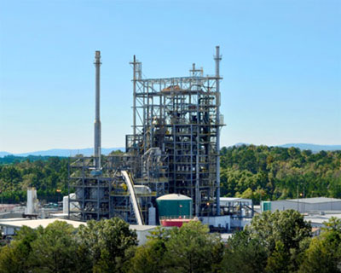
Carbon Capture
Sub-program is focused on the development of post-combustion and pre-combustion CO₂ capture technology for new and existing industrial and power-producing plants
FY 2015 Request: $77.0 Million
Post-Combustion Capture Systems ($65 Million)
Pre-Combustion Capture Systems ($12 Million)
The National Carbon Capture Center in Wilsonville, Alabama

Slide 8
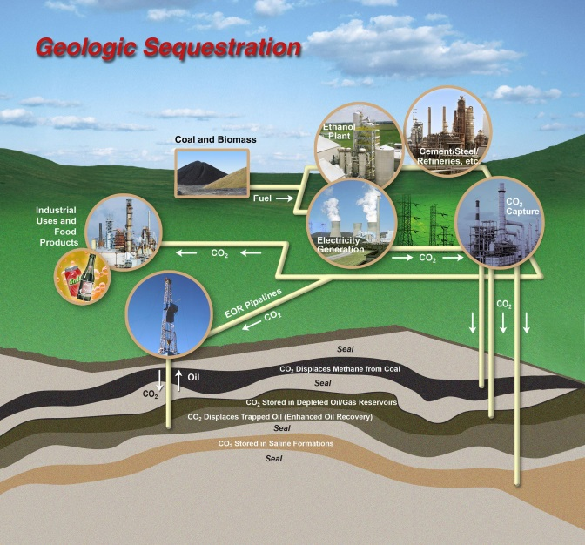
Carbon Storage
Sub-program advances safe, cost-effective, and permanent geologic storage of CO₂
FY 2015 Request: $80.1 Million
Storage Infrastructure [formerly Regional Carbon Sequestration Partnerships] ($60.8 Million)
Geologic Storage Technologies ($8.5 Million)
Monitoring, Verification, Accounting and Assessment ($4.5 Million)
Focus Area for Carbon Sequestration Science ($7.0 Million)

Slide 9
Advanced Energy Systems
Sub-program focuses on improving the efficiency of fossil fueled power systems, enabling affordable CO₂ capture, increasing plant availability, and maintaining the highest environmental standards
FY 2015 Request: $51.0 Million
Advanced Combustion Systems ($15.0 Million)
Gasification Systems ($22.0 Million)
Hydrogen Turbines ($11.0 Million)
Solid Oxide Fuel Cells
($3.0 Million)

Slide 10
Cross-Cutting Research
Development of new materials, catalysts, instrumentation and sensors, and advanced computer systems that will be used in future power plants and energy systems
FY 2015 Request: $35.3 Million
Plant Optimization Technologies ($7.04 Million) Sensors and Controls; Materials R&D; Water Management; Other Novel Concepts
Coal Utilization Science ($23.5 Million) Computational Systems Dynamics; Computational Energy Science
Energy Analyses ($0.85 Million) Environmental Activities; Technical and Economic Analysis
University Training and Research ($2.75 Million) University Coal Research; Historically Black Colleges and Universities Education and Training
International Activities ($1.1 Million)

Slide 11
Natural Gas Technologies
Develop technologies to minimize the environmental impact of natural gas production, transport and storage and conduct research to improve our understanding of gas hydrates.
FY 2015 Request: $35.0 Million
Environmentally Prudent Development [formerly Effective Environmental Protection] ($15.3 Million) R&D collaboration with EPA & USGS on water quality and availability, air quality, induced seismicity, and mitigating shale gas development intensity
Emissions Mitigation from Midstream Infrastructure ($4.7 Million) new program focused on reducing methane emissions
Gas Hydrates ($15.0 Million) scientific testing to evaluate the occurrence, nature and behavior of naturally occurring gas hydrates and resulting resource, hazard, and environmental implications
Notes:
Shale Gas
Fund the recommendations from the SEAB Shale Gas production Subcommittee.
Collaborate with EPA and USGS to understand and minimize the potential environmental, health, and safety impacts of gas development including hydraulic fracturing.
Hydrates
Evaluate hydrates as a potential energy source for the Nation.

Slide 12
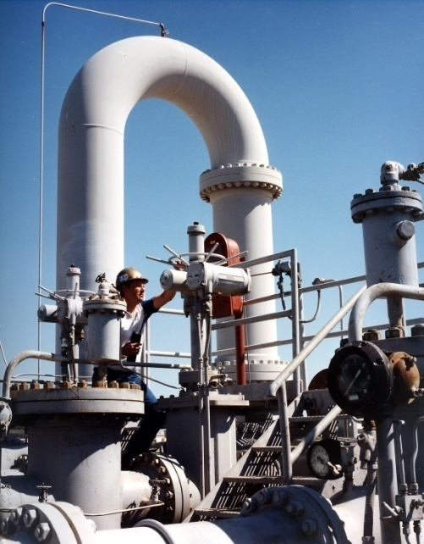
Strategic Petroleum Reserve
Provides “Emergency Stockpile” of crude oil to respond to potential disruptions in U.S. petroleum supplies (international or domestic)
FY 2015 Request: $205.0 Million
FY 2015 funding provides for:
Operations and security of SPR’s four storage facilities
Cavern maintenance, testing and remediation
Mitigation of loss of cavern storage capacity
Degasification of crude oil inventory to ensure its availability
Increased support for major maintenance requirements
Notes:
SPR Management & Operations:
SPR Facilities Operations and Security.
Four U.S. stockpiling facilities with total capacity of 727 MMB.
Emergency Readiness to protect U.S. energy security.
(SPR drawdown capability of 4.25 million barrels/day).
Oil Degasification to assure safe vapor pressure of oil stocks.
Relocation of SPR degasification plant to West Hackberry site.
Cavern Maintenance to assure storage integrity.
Cavern well casing inspections & remediation (State Reqmt).
SPR Petroleum Account:
Reduction of $291Million .
Permanent cancellation of sales receipts from the SPR Drawdown in 2011.

Slide 13
Other Petroleum Reserves
Northeast Home Heating Oil Reserve
FY 2015 Request: $1.6 Million
Ready to Respond to Fuel Oil Emergencies in the Northeast
Established in 2000 as “Emergency Stockpile” to respond rapidly to winter related shortages of heating oil
Maintain one million barrels of ultra-low sulfur diesel at locations in New England with resolicitation of both expiring commercial terminal contracts.
($6 million of prior year funds will be used, bringing total FY2015 to $7.6 million)
Naval Petroleum & Oil Shale Reserves
FY 2015 Request: $20 Million
NPR-1: (Elk Hills, CA): Continue environmental remediation activities to attain
release from the environmental findings related to the sale of NPR-1.
NPR-3 (Casper, WY): Disposition of NPR-3 through competitive sale.
Transfer to private ownership planned for December 2014. Production
facilities remain operational and environmental remediation continues until
transferred.
Elk Hills School Lands Fund
FY 2015 Request: $15.6 Million
Final payment to the California State Teachers’ Retirement System for its claim to land
within NPR-1.

Slide 14
For More Information
facebook.com/FossilEnergy
www.fossil.energy.gov
twitter.com/fossilenergygov

